Slide 1
GAIHN
HAI PPS - REDCap
On – Site Training Slides
May 2023

Slide 2
GAIHN HAI PPS Overview
CDC and APHL are working in conjunction with Implementing Partners (HSP and CRDF) to develop a data collection tool that will be used by facilities in the Global Action in Healthcare Network (GAIHN). The purpose of this tool is to collect Hospital Associated Infection (HAI) patient data at one point in time to increase surveillance and prevention methods in the selected facilities.
Our team has designed and developed a Point Prevalence Survey (PPS) data collection tool that provides information for HAI determination based on inputted patient data for the following HAIs:
Pneumonia (PN)
Blood Stream Infection (BSI)
Urinary Tract Infection (UTI)
Surgical Site Infection (SSI)
PPS Data Collection
[CDC may update language]
Environment Type | Data Collector | Facility Administrator
Test Environment – Patient Forms | Data collectors can access this environment to practice creating records, entering data, and submitting records for each patient. DUMMY DATA ONLY | Facility admin can access this environment to practice navigating to submitted records and reviewing data.
Production Environment– Patient Data Collection | Data collectors should use this environment to create and submit records for each patient (Real Data Collection) | Facility admin should use this environment to verify locked records submitted by data collectors to ensure data quality
Production Environment – Facility/Ward Data Collection | N/A | Facility admin should use this environment to create a record for their facility and enter facility demographics data. Additionally, admins will enter ward demographics data for each ward that is included in the PPS within their facility.
REDCap Environments + User Roles

Slide 3
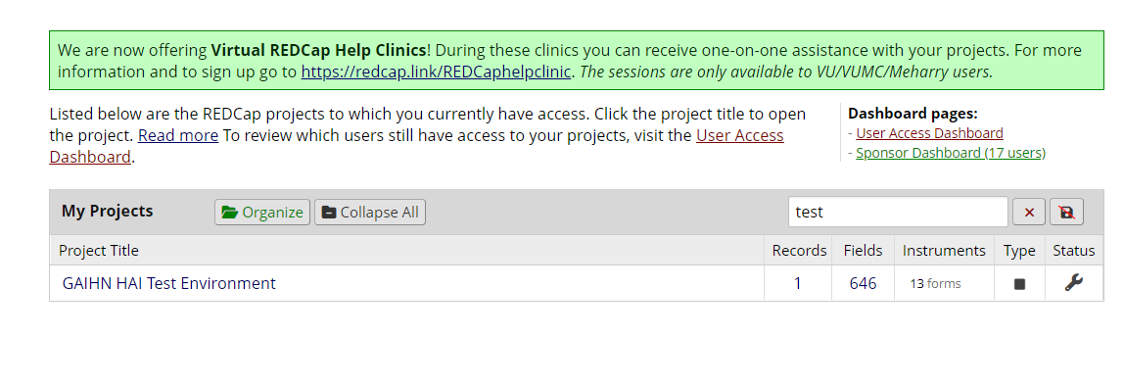
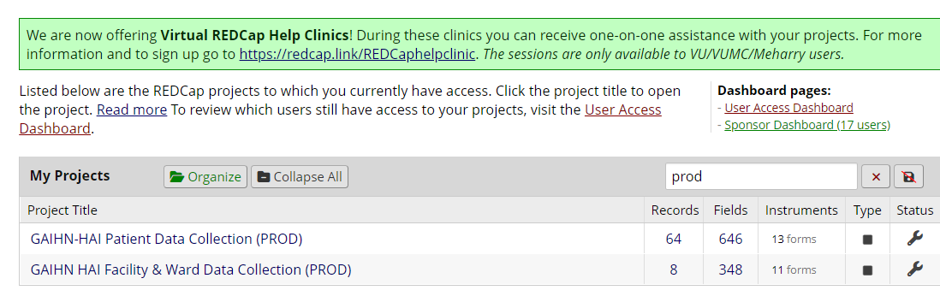
Accessing the REDCap
TEST environment onboarding
    Each facility group will be added to the Test environment with multiple test accounts per facility (Data Collector accounts + Facility Admin accounts)
    Each facility will receive an onboarding email with their test account credentials (These credentials will allow users to only access the Test Environment)
    Test users can login at this link using their given credentials: https://redcap.vanderbilt.edu/
    Once logged in, click on My Projects and “GAIHN-HAI Test Environment” to access the project
PROD environment onboarding (for Facility/Ward + Patient Data Collection)
    All users will be added to the Prod environment and receive an email prompting you to create a REDCap account
    Once you create an account users can login using this link: https://redcap.vanderbilt.edu/
    Upon login, you will be prompted to enter your credentials and pass a two-step verification wall (users can verify using their phone or email)
    Once logged in, click on My Projects and choose the project you would like to access (Note: Data Collectors will only have access to the Patient Data Collection Prod Environment)

Slide 4
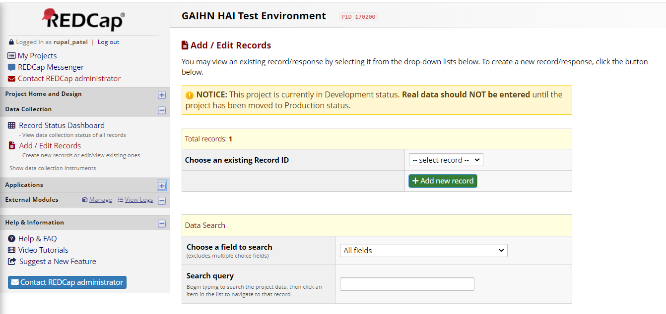
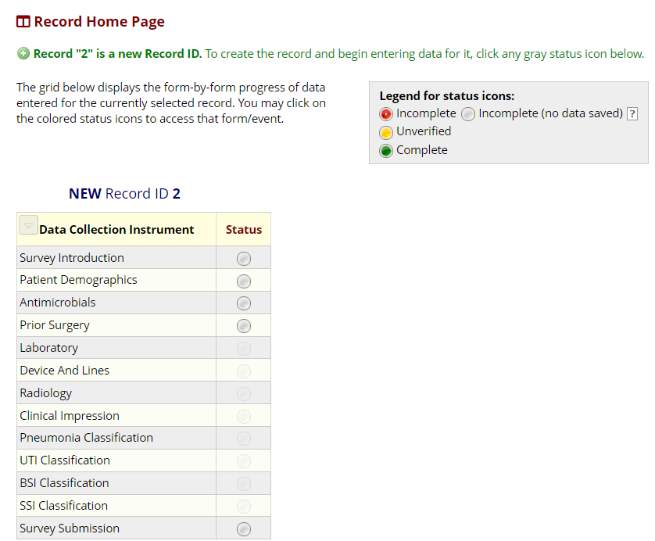
Creating a Patient Record
Navigate to the Add/Edit Records tab on the left side of the screen
Click on the Green ‘Add new record’ button
You will then be navigated to the Record Home Page to begin the survey
To begin the survey, click on the Grey status circle next to the first form

Slide 5
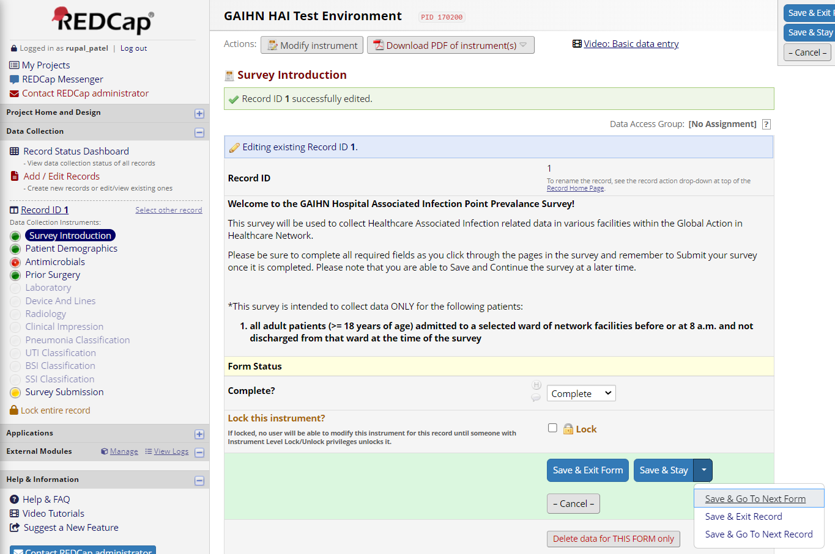
Navigation Pane/Form Status
Once a record is created a navigation pane will appear on the left side containing all forms in the survey – users can click on different forms to navigate to that form
      NOTE: Certain forms will be greyed out until necessary criteria is met (not all forms need to be accessed – this is based on certain data entered)
As users go through the survey, the form status must be updated based on the completeness of data entered
  Complete = green status
  Incomplete = red status
Click on Save & Go to next form once until all forms are complete (marked green)

Slide 6
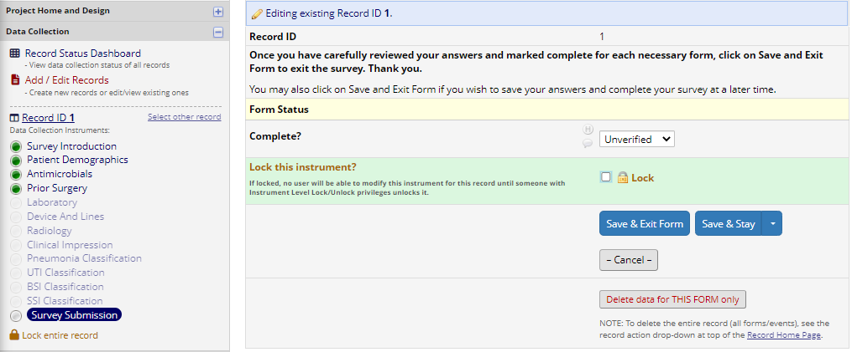
Submitting/Saving a Patient Record
Once all forms are Complete (Green status), users should navigate to the Survey Submission page and mark the form status as Unverified (yellow)
Click on Save & Stay to save the form status
Click on Lock entire record at the bottom of the navigation pane to alert a facility admin that the record is ready for review
        NOTE: A record is ready for review by a facility admin when the Survey Submission Status is Unverified (Yellow status) and the record is locked
    Users can then click on Save & Exit Form to navigate to the Record Home Page

Slide 7
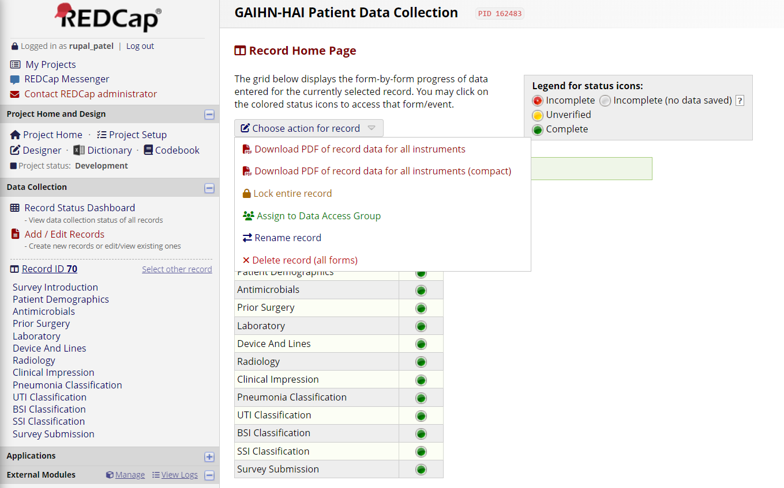
Record Home Page
After saving and exiting the form, users will be navigated to the Record Home Page
Users can click on the ‘Choose action for record’ drop down list to complete different actions for the record
Rename record?
Note: Users can also access a record’s Home Page by navigating to the Record Status Dashboard and clicking on the Record ID name

Slide 8
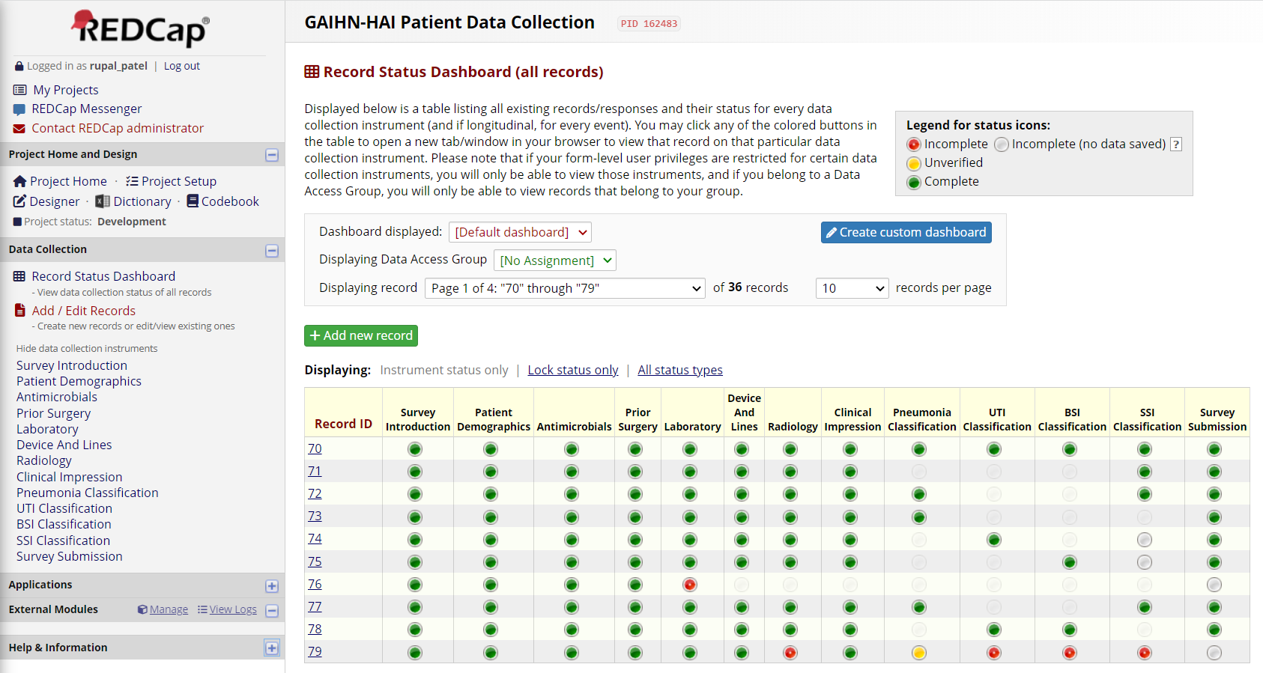
Record Status Dashboard
Users can access the Record Status Dashboard to view the record status of all patient surveys for their facility
Click on a Record ID to navigate to the Record Home Page
Click on a status circle in a record to navigate to that specific form in the survey
  NOTE: Users should only be able to view data in records that they create

Slide 9
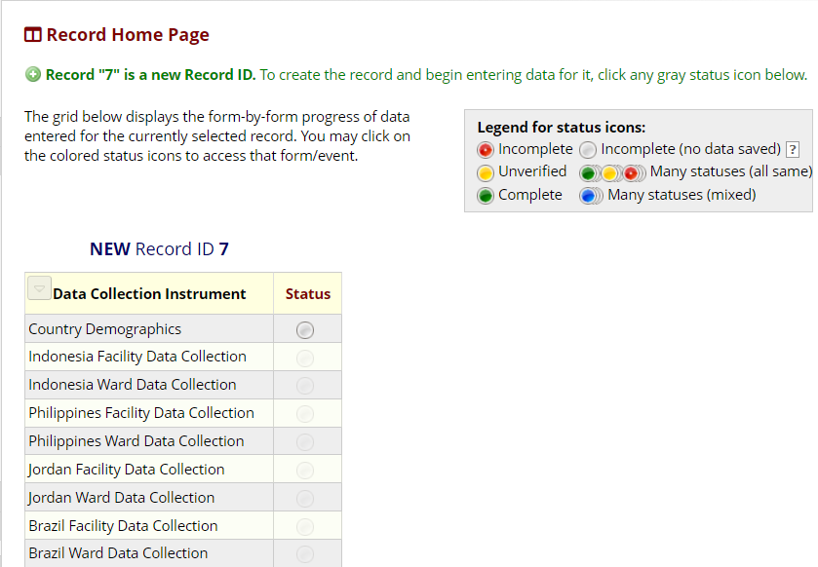
Creating a Facility/Ward Record
Facility/Ward Production Environment
Facility Administrators will need to access the Facility/Ward Data Collection Prod Environment to enter and submit Facility/Ward records
Note: A record will need to be created for each facility that is participating in the PPS. Multiple wards can be associated with a facility by adding additional instances in the Ward Form.
To create a new record, navigate to the Add/Edit Records tab on the left side of the screen
Click on the Green ‘Add new record’ button
You will then be navigated to the Record Home Page to begin the survey
To begin the survey, click on the Grey status circle next to the first form

Slide 10
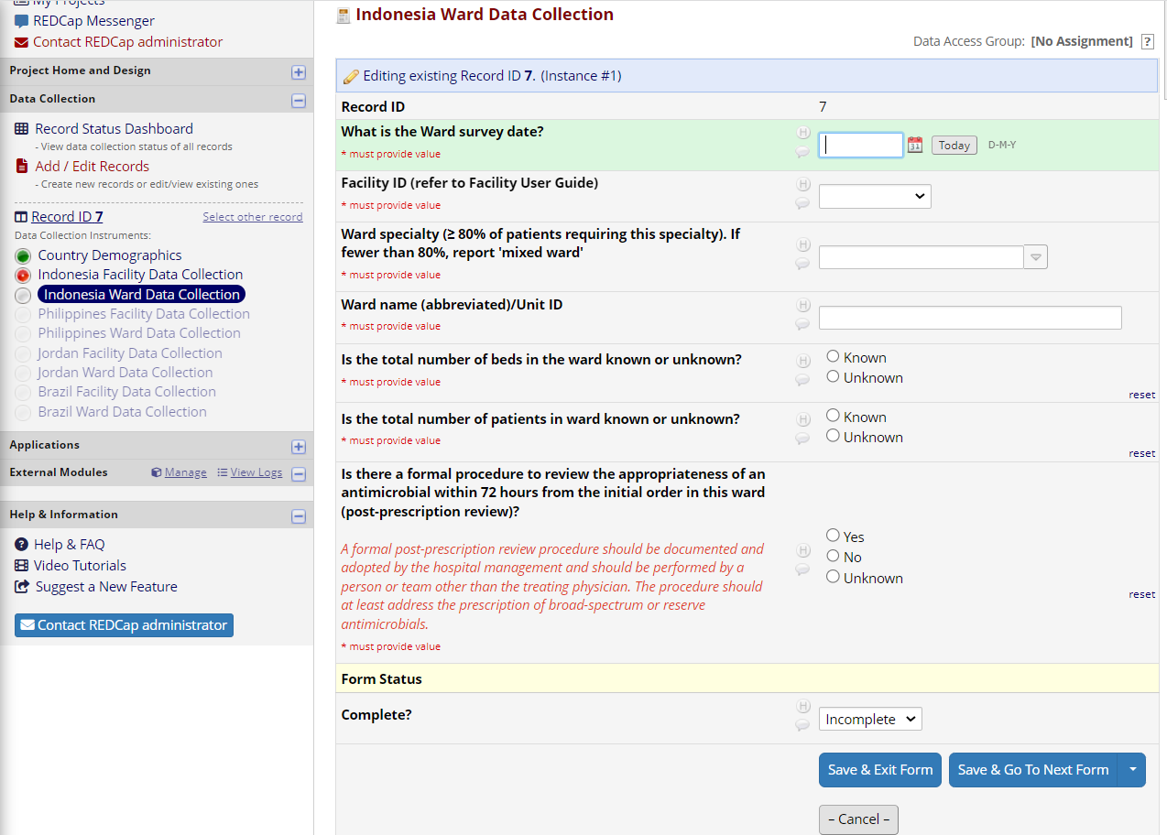
Navigation Pane/Form Status
Facility/Ward Production Environment
Once a record is created a navigation pane will appear on the left side containing all forms in the survey – users can click on different forms to navigate to that form
      NOTE: Certain forms will be greyed out until necessary criteria is met (not all forms need to be accessed –this is based on certain data entered)
As users go through the survey, the form status must be updated based on the completeness of data entered
  Complete = green status
  Incomplete = red status
Click on Save & Go to next form once until all forms are complete (marked green)

Slide 11
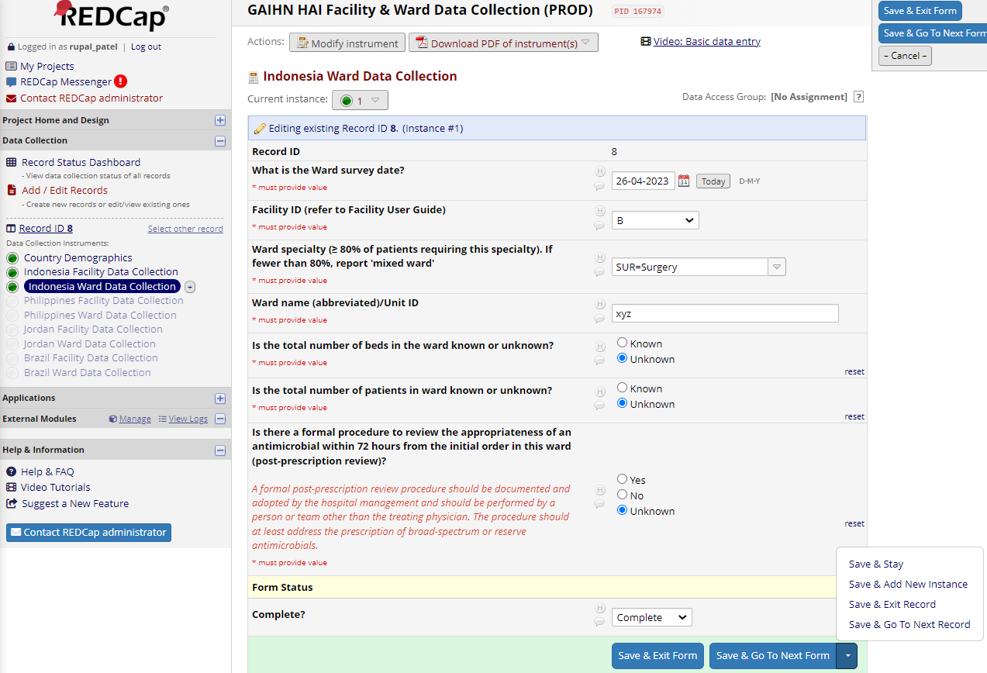
Adding Additional Wards
Facility/Ward Production Environment
Once you have finished entering data for the facility form and updated the status to Complete (green circle), Click on ‘Save and Go to Next Form’
You will then be navigated the ward form to enter data for the first ward in that facility that will be included in the PPS
If there is only one ward in the facility for this PPS: Complete form and update the form status to Complete and click ‘Save and Exit Form’
If there are multiple wards in the facility that will be included in the PPS: Complete the ward form and update the status to complete. Then, click on the drop-down button next to Save and choose ‘Save & Go to Next Instance’ to create an additional ward form. Repeat this process until all data for all included wards are entered
Once all ward forms are complete (Green circle), click on ‘Save and Exit Form’
Note: to toggle between ward forms click on the “current instance” dropdown menu at the drop

Slide 12
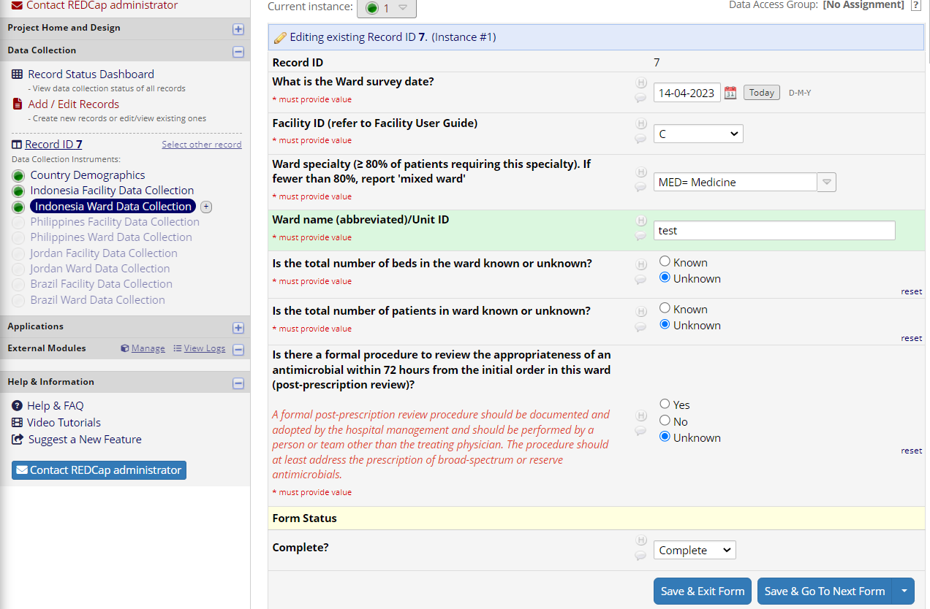
Submitting/Saving a Record
Facility/Ward Production Environment
Once all forms are Complete (Green status), users should Click on Save & Exit Form
Users will then be navigated to the Record Home Page

Slide 13
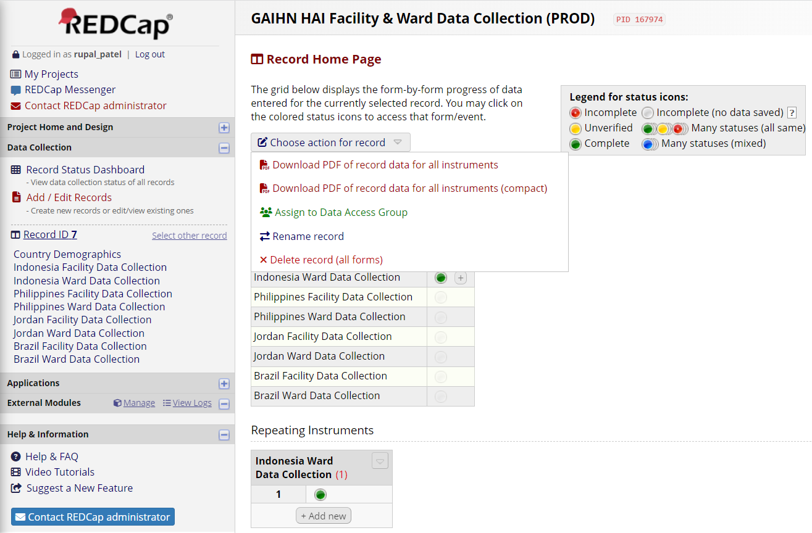
Record Home Page
Facility/Ward Production Environment
After saving and exiting the form, users will be navigated to the Record Home Page
Users can click on the ‘Choose action for record’ drop down list to complete different actions for the record
Rename record?
Note: Users can also access a record’s Home Page by navigating to the Record Status Dashboard and clicking on the Record ID name

Slide 14
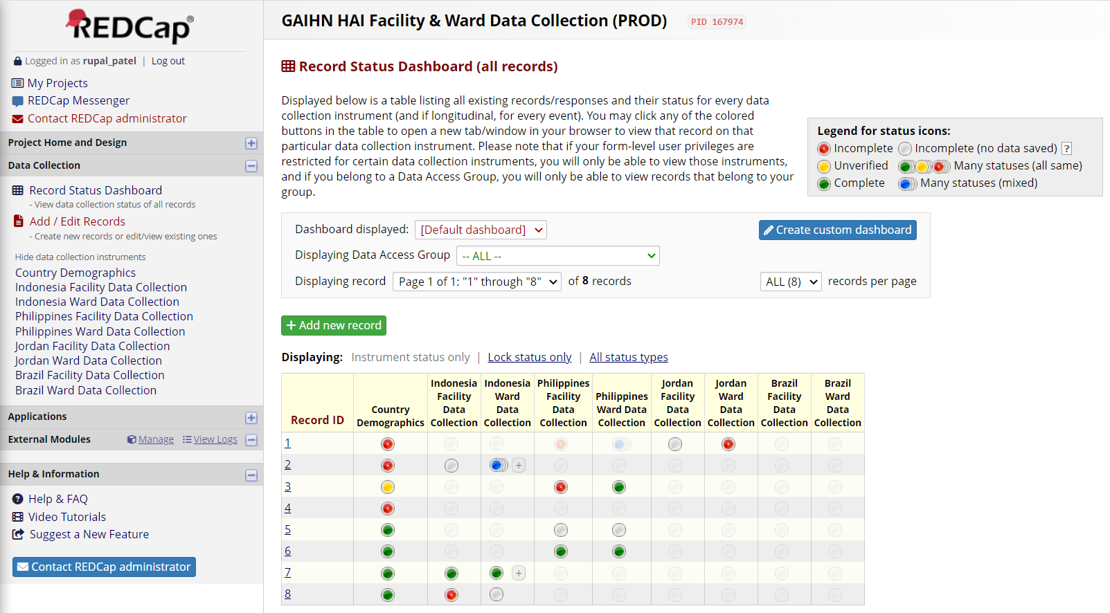
Record Status Dashboard
Facility/Ward Production Environment
Users can access the Record Status Dashboard to view the record status of all facility surveys for their facility
Click on a Record ID to navigate to the Record Home Page
Click on a status circle in a record to navigate to that specific form in the survey
  NOTE: Users should only be able to view data in records that they create

Slide 15
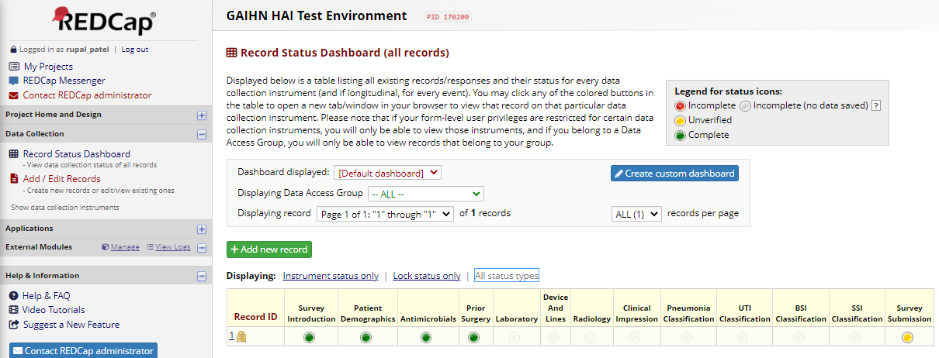
Verifying a Patient Record
Patient Production Environment
Facility Administrators will need to access the Patient Data Collection Prod Environment to view and verify patient records
To access records for your facility, admins can navigate to the Record Status Dashboard. This dashboard shows the status of all patient records for your facility by form.
Filter the dashboard to ‘Lock Status Only’ to view patient records that are ready for review
        NOTE: A record is ready for review by a facility admin when the Survey Submission Status is Unverified (Yellow status) and the record is locked
Click on a Record ID to navigate to the Record Home Page or click on a status circle in a record to navigate to that specific form in the survey

Slide 16
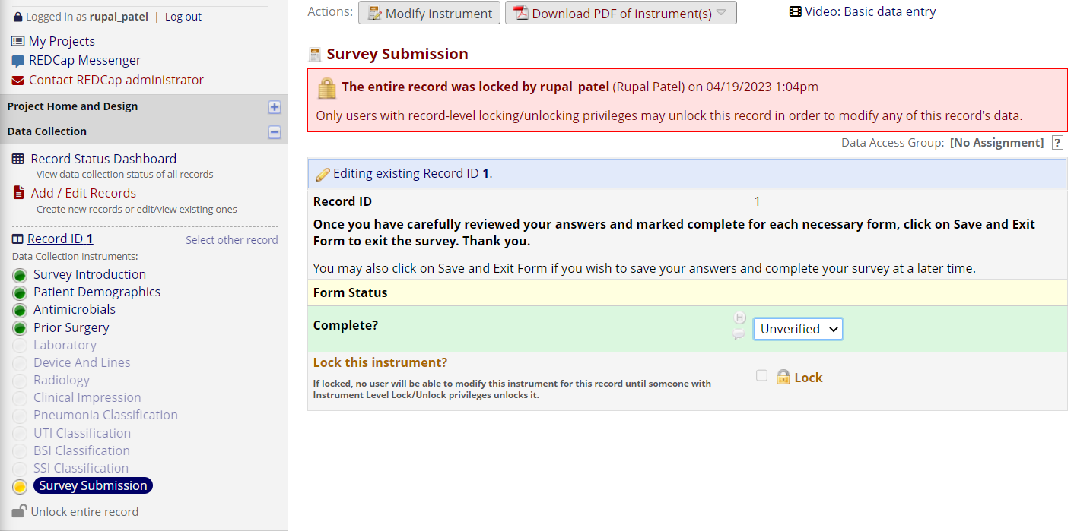
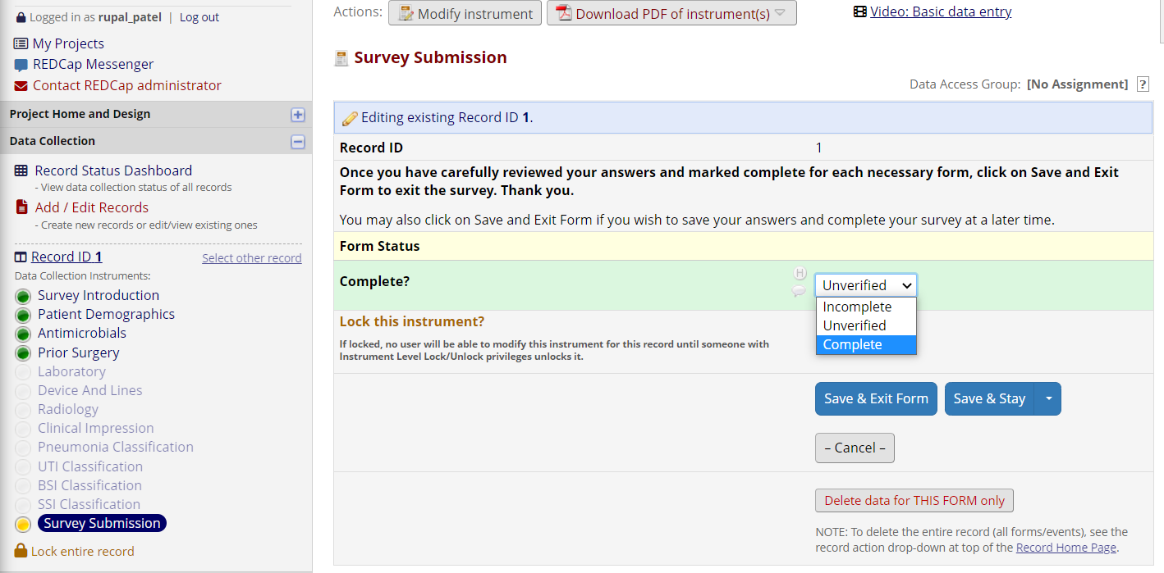
Verifying a Patient Record (cont.)
Patient Production Environment
Once you have reviewed/verified all data in the survey, navigate to the Survey Submission form
Click on ‘Unlock entire record’ to update the form status of the Survey Submission form
Then change the form status of the Survey Submission form to Complete to indicate that this record has been reviewed by a facility admin
Click ‘Save & Exit Form’ to save the form status
You will be then be navigated to the Record Home Page

Slide 17
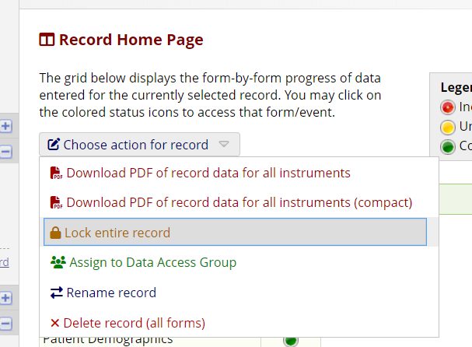
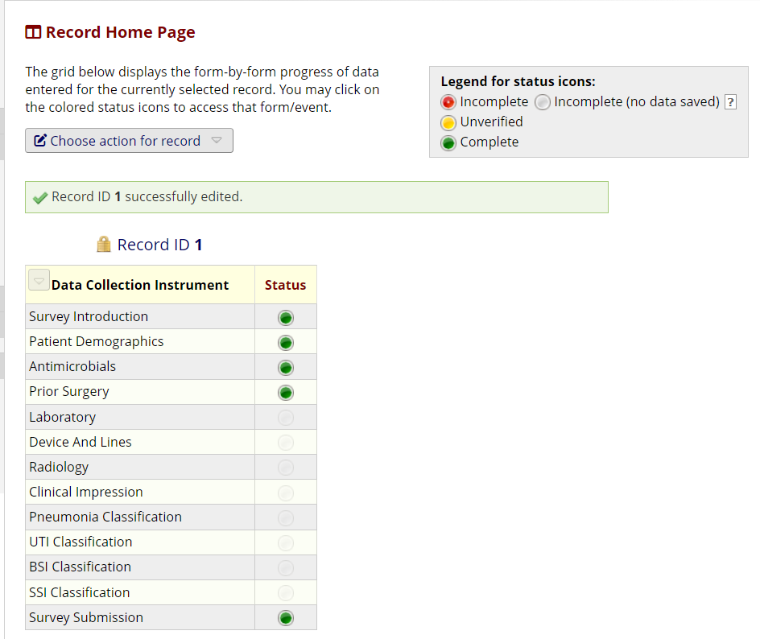
Verifying a Patient Record (cont.)
Patient Production Environment
Click on the ‘Choose action for record’ then click on ‘Lock entire record’ to ensure that the data within the record cannot be changed by other users
Ensure that all forms in the survey are Complete (Green status)
Note: A record has been verified by a facility admin if the Survey Submission Status is Complete (Green) and the record is locked

Slide 18
REDCap Tips & Reminders
Please note that while navigating the REDCap there are a few reminders all users should keep in mind for successful data collection:
Facility/Ward Data should be collected before patient data collection begins
At the bottom of every form, be sure to update the Form Status to ensure data is being tracked correctly
  Users should mark Complete (green circle) once they are finished entering data on that page
  Users should mark Incomplete (red circle) if that page is in progress / the user will need to return at a later time to finish entering data
  Users should mark the Survey Submission page (last page in the Patient survey) Unverified (yellow circle) to indicate that their record is ready to be reviewed by a Facility Admin
At the bottom of every form, be sure to click on the blue ‘Save & Go to Next Form’ button to ensure your data is being saved. This will need to be done on every page in the survey. Note, users may have to click on a dropdown arrow on this button to access the Save action they would like to execute
If users need to complete forms offline/on paper:
Facility/GAIHN Admins can access the ‘Designer’ feature within REDCap and print PDFs of each form within the Patient and Facility/Ward projects

