Slide 1
GAIHN
HAI PPS
Web App
On – Site Training Slides
November 2024
Notes:
Hello and welcome to the GAIHN-HAI Point Prevalence Survey training curriculum. This session will provide information on accessing and using the GAIHN-HAI PPS web app for data entry and data export

Slide 2
GAIHN HAI PPS Overview
The gaihn-hai.org web app data collection tool has been developed by CDC and APHL in conjunction with implementing partners for use by healthcare facilities to collect patient data for a healthcare associated infection point prevalence survey (PPS)
The Point Prevalence Survey (PPS) data collection web app provides data for HAI determination based on inputted patient data for the following HAIs:
Pneumonia (PN)
Blood Stream Infection (BSI)
Urinary Tract Infection (UTI)
Surgical Site Infection (SSI)
PPS Data Collection
GAIHN-HAI.org PPS Web App
The Point Prevalence Survey app provides role-based user access and user management to support collection of de-identified patient records, facility and/or ward surveys. It is a responsive system in which users are guided through the complex HAI PPS process by following a series of simple step-by-step instructions and data collection forms. It provides control and flexibility in managing accounts, patient surveys, and wards for different facilities, while also supporting data export and enabling future interoperability with other analytic/visualization tools.

Slide 3
GAIHN-HAI PPS app user roles
 | Data Collector | Survey Administrator | System Administrator
Description | Facility staff with primary role of chart review and patient data entry | Facility staff with primary role of overseeing data collectors and facility/ward data entry | CDC or implementing partner with primary role of managing app systems and user invites
Responsibilities | Create and submit patient records * Data collectors only have access to the patient records that they have created for verifying and editing data | Enter facility data. Create wards and enter ward data for each ward that is included in the PPS within their facility. Create and submit patient records Edit or delete patient records entered by other data collectors * Survey administrators have access to all patient records in their facility for verifying and editing data | Create Facilities and Surveys and updates Invite Data Collectors and Survey Administrators for system access Assign users to surveys Remove users from a survey Remove data collectors and survey administrators from system Views invited and existing users Act as first-line support for data collectors and survey admin with account issues that can be resolved within the application
Notes:
The GAIHN-HAI web app supports three different types of users. Data collectors, who are typically staff from the healthcare facility who’s primary role is chart review and entry of patient data, survey administrators, facility staff whos primary role is to oversee data collectors and enter information on the facility and wards included in the PPS, and system administrators, typically CDC or implementing partner staff whose primary role is to manage the system and invite users to the system. The responsibilities for each of the three types of users is shown here. For data collectors, their responsibilities include creating and submitting records for patients included in the PPS. Data collectors only have access to the patients that they have created in the PPS. The responsibilities of survey administrators include: entering information on the facility and information about individual wards that are included in the PPS. Like data collectors, survey administrators are also able to create and submit patient records. Survey administrators are also able to edit or delete patient records entered by others, and have access to the records of all patients in their facility for the purpose of verifying and entering data. System administrators do not enter any data into the PPS, but are primarily responsible for creating facilities within the data collection tool, inviting users to the PPS, and assigning them to surveys. System administrators also act as first-line support for data collectors and survey admin with account issues that can be resolved within the application. In this module, we will focus on guidance for data collectors and survey administrators
focus primarily

Slide 4
GAIHN-HAI PPS app environments and user roles
Test Environment
https://gaihn-hai.sandbox2.aimsplatform.com/
  Practice creating facility/ward/patient records, entering, and submitting data
  Generic user logins available OR can request user accounts linked to email address
  Avoid entering real patient data
Production Environment
https://gaihn-hai.org
  Real data collection
  User accounts linked to email address
Notes:
There are two separate web pages in which users can access the web app. The first, is the test environment. The purpose of this environment is to allow for users to practice entering data in preparation for the PPS. Users may have their own account linked to their email address created in the test environment, or use a generic facility login provided by the PPS team. The production environment, is where real PPS data collection will occur. User information and data is NOT shared between the two environments, and real patient data should ONLY be entered into the production environment.

Slide 5
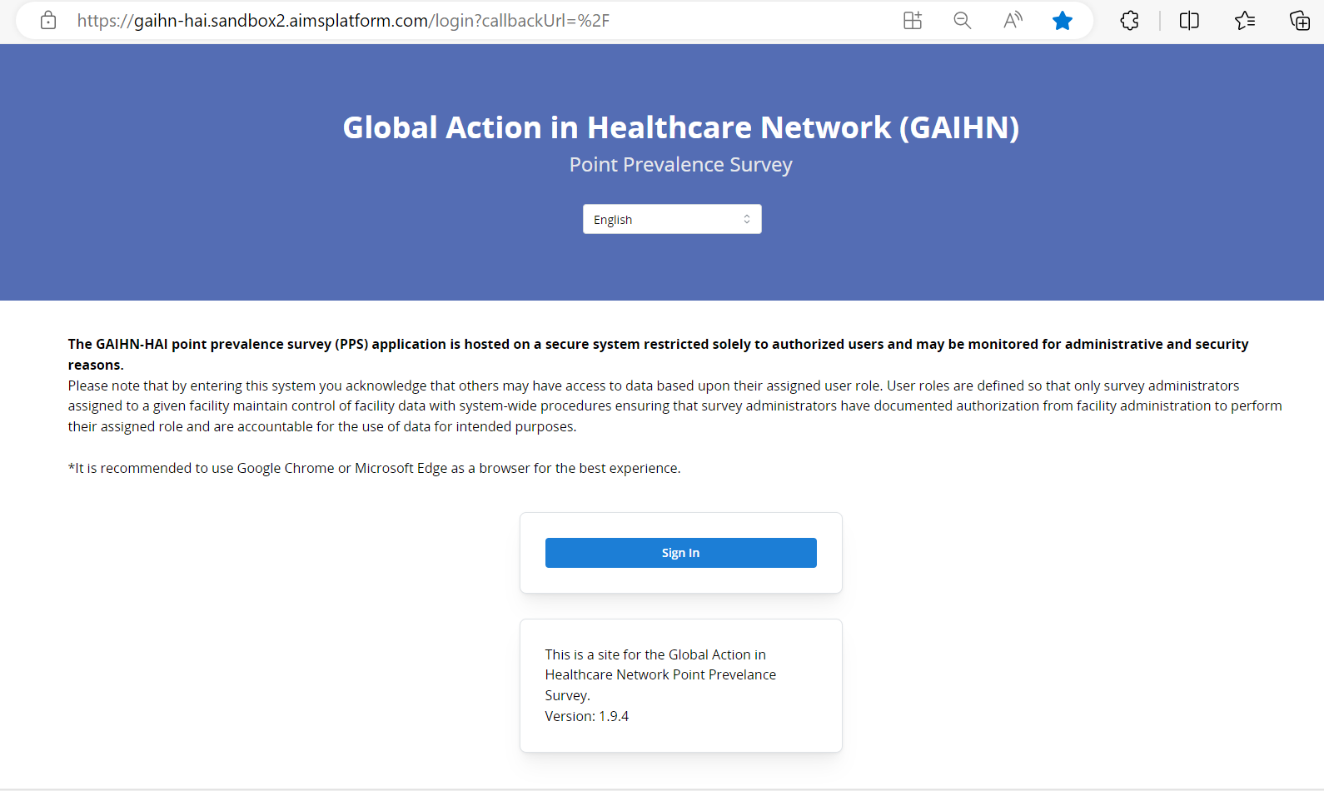
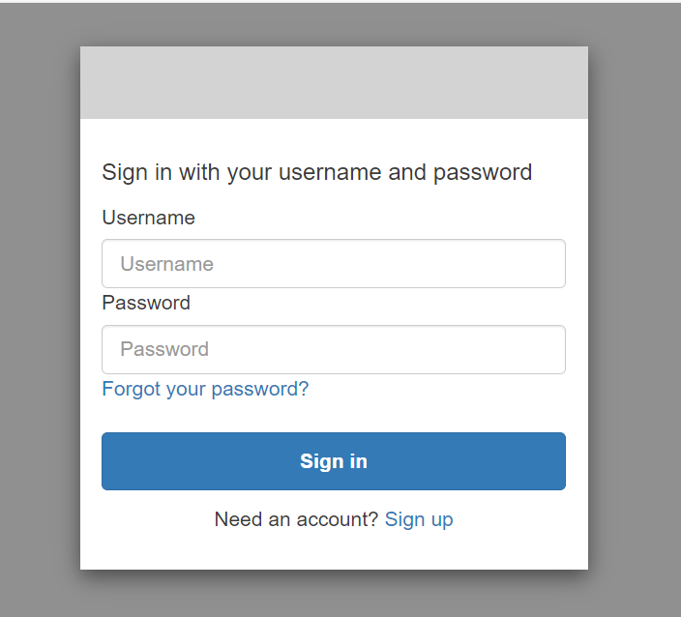
Accessing the app test environment
Login steps
TEST environment login
    Users can login using generic user accounts, or request to create their own accounts within the test environment
    Test users can login at this link using their given credentials:
    https://gaihn-hai.sandbox2.aimsplatform.com/
    Users can select the language they would like to use within the app on the login page or at any other page in the app
Step 1
Step 2
Notes:
In order to access the test environment, facility users can use either pre-existing generic user accounts, or request to create their own accounts within the test environment linked to their email address. Users can log in to the test environment using the link showed on this page. After accessing the web link, the process for logging into the test environment is shown on the right side of this page CLICK . Users can select the language they would like to use within the app on this login page or at any other page in the app CLICK

Slide 6
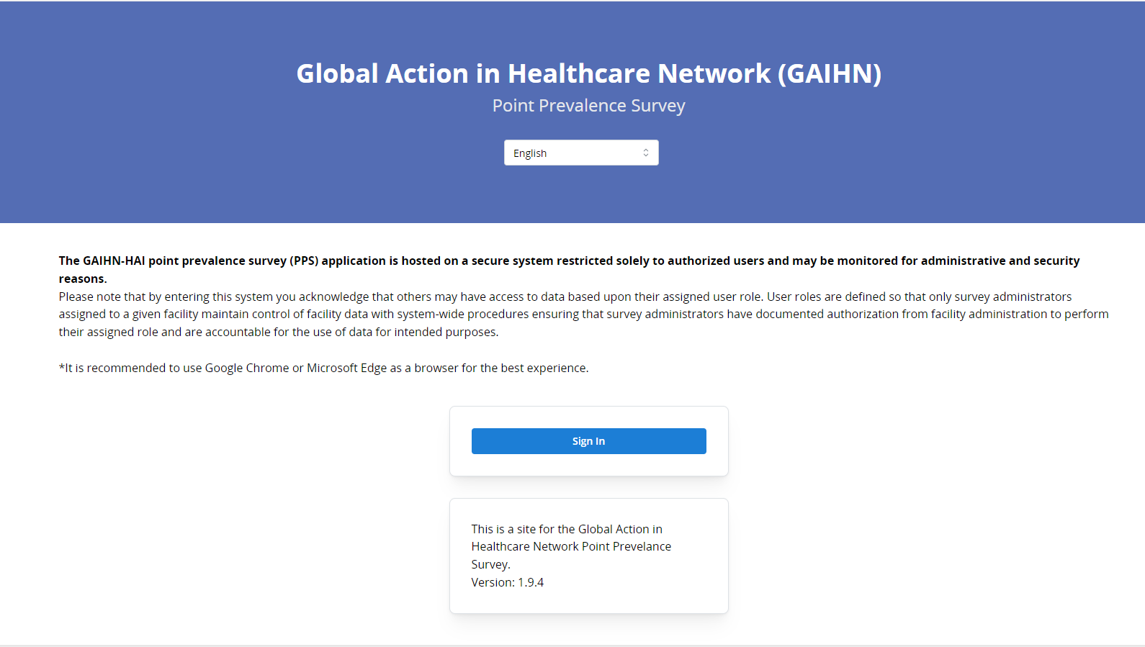
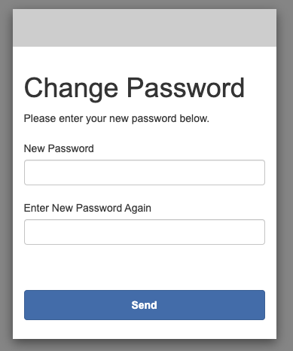
Accessing the app production environment
Login steps
Production environment user Account Access and Creation
    Survey administrators and data collector accounts will be created and assigned to surveys by system administrators (IE CDC or implementing partner staff)
    Survey administrator accounts can only be created after approval of Survey Admin Access Request Form (see next slide for instructions)
    Once an account is created, users will receive an email with a temporary password and can login using this link:
    https://gaihn-hai.org/
    Users will be prompted to set their own password
Step 1
Enter the provided credentials from the e-mail into the fields. If you receive the error: “Temporary password has expired and must be reset by an administrator.”, then the user will need reach out to the system admin to recreate the account. The admin will need to remove the account and then re-invite the user
Step 2
Step 3
Notes:
In order to access the production environment, where real data entry occurs, both survey administrators and data collectors must have accounts created and be assigned to the survey. System administrators (generally CDC or implementing partner staff) wil lwork with survey administrators and data collectors to create these user accounts, and assign them to the appropriate survey. Because they have access to all of the data in the facility for editing and deleting, survey administrators need to fill out an additional form that verifies that they are associated with the surveyed healthcare facility before an account can be created. This form is described on the next slide. Once an account is created, both data collector and survey admin users will receive an email with a temporary password that will allow them to log in to the app using the link shown: GAIHN-hai.org. The right side of this slide shows the process by which new users login using their temporary password and will be prompted to create a new password. Temporary passwords are only valid for 7 days, so If the user receives any errors during this process, they should reach out to the system admin to reinvite the user.

Slide 7
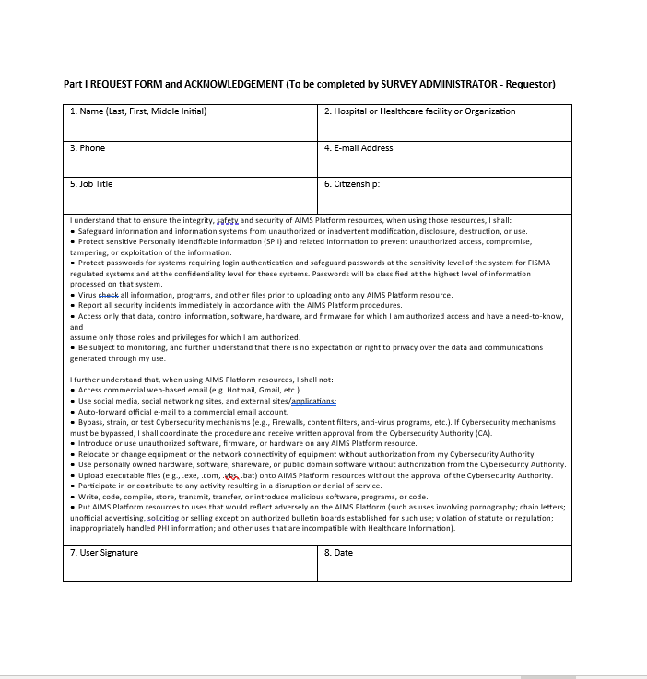
Survey admin access request form (docusign)
Access Request Processing and Approval
List of Survey Administrators for a Facility survey is provided to CDC or implementing partner
Web app service desk sends the Survey Administrator Access Request Form in a docusign format via e-mail to each individual survey administrator
The Survey Administrator completes Part I of the form
A Facility Administration point of contact (POC) endorses the survey administrator via docusign.
Approvals are confirmed.
System administrator creates survey administrator invite/access in the application.
Notes:
The survey admin request form shown on this page is used to verify the affiliation of survey administrators with the healthcare facility, to ensure that they should have full access to the PPS records. After the facility shares who they would like to include as survey administrators with CDC or a CDC implementing partner, they should receive a message to fill out this request form. The survey administrator completes part I of the form, shown here, and this form then requires a second signature endorsement from a facility administration point of contact at the facility. Once the form is filled out via docusign and the approvals are confirmed, a survey administrator account will be created, and the survey administrator should receive an email inviting them to the web app with a temporary password

Slide 8
Patient Data Entry for Data Collectors
Notes:
We will now go over the process of entering data for patients included in the survey. Patient data entry is the primary task performed by data collectors, although survey admins can also enter patient data as needed and can refer to this guide as well

Slide 9
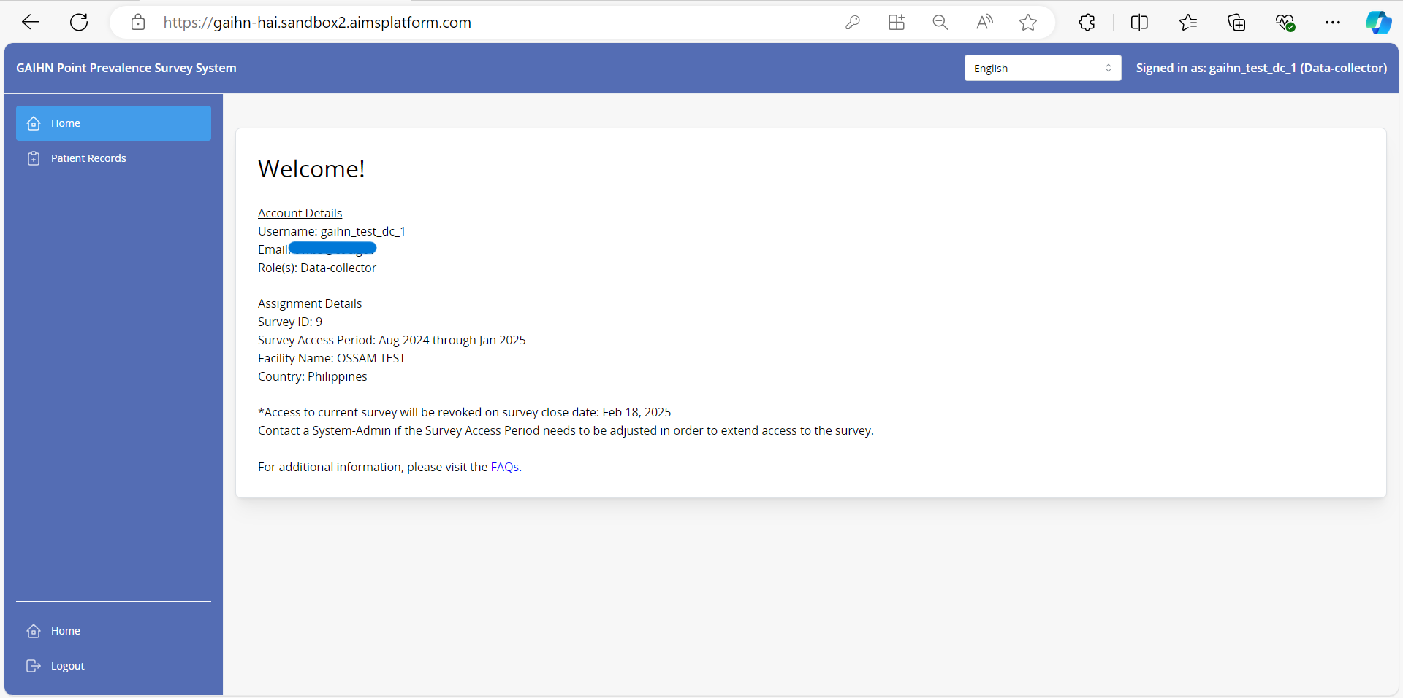
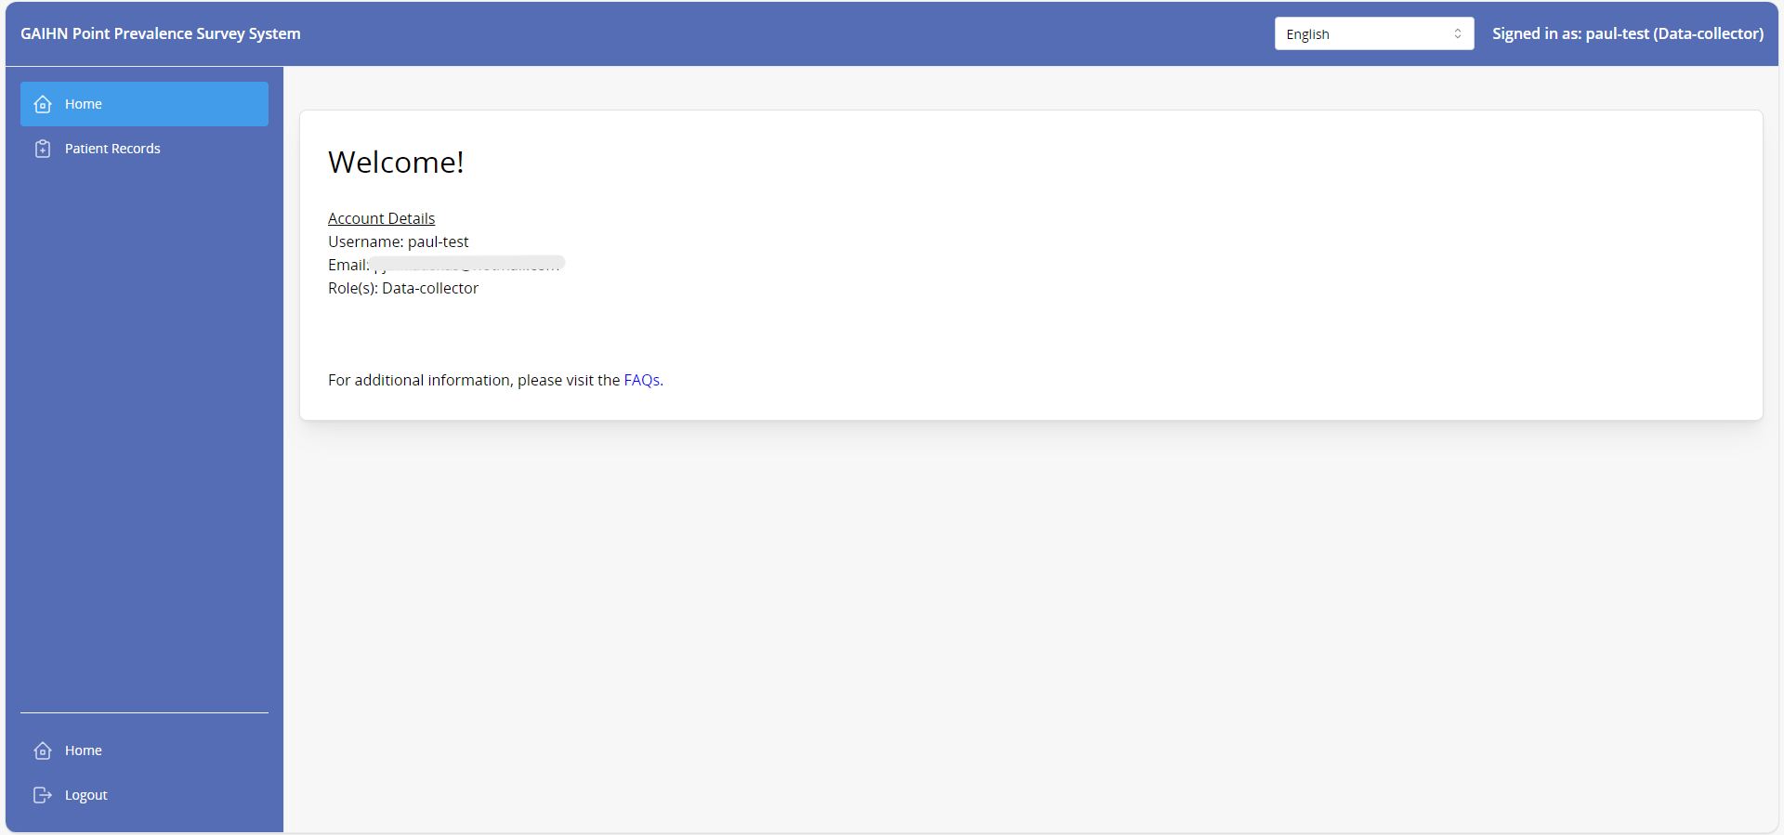
Home Page
Assigned to a survey
If NOT assigned to a survey
After log in, if you are assigned to a survey, you will see your account details; and assignment details. Your assignment details include the Survey ID; Facility; Country and Survey Access period.
When you login and are NOT assigned to a survey yet, you will only see your account details (as below). Contact your survey administrator so that the system administrator may assign you to a survey.
Notes:
Upon first logging into the application, you will see a different screen depending on whether or not you have been assigned to a survey.
If assigned to a survey, you will see their account details; and assignment details such as the survey ID; Facility; Country and Survey Access period.
If not yet assigned to a survey, you will only see their account details and will not be able to enter any patient records. If not yet assigned to a survey, you should contact their survey administrator.

Slide 10
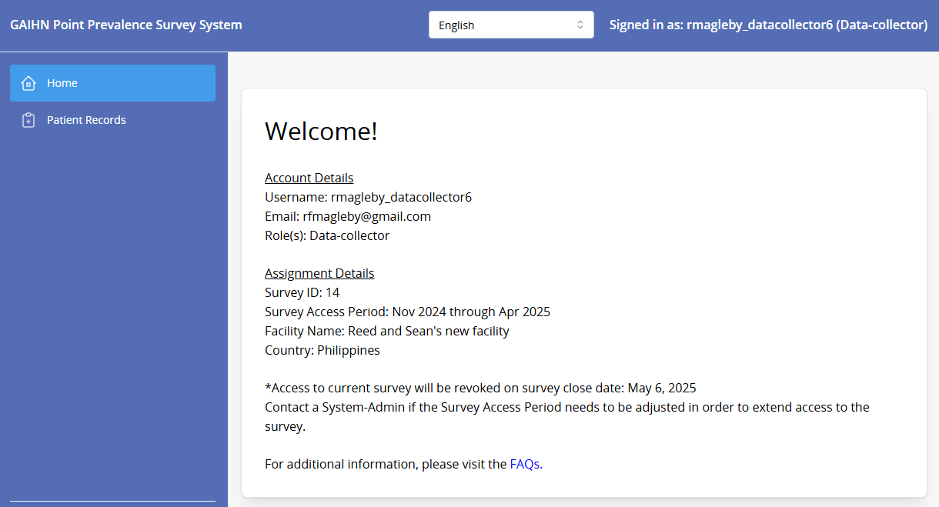
Home Page
On this page and on any other page in the app, you can select the language that you would like to use within the app
The FAQ link provides access to a document with answers to frequently asked questions about the PPS
Notes:
On the welcome page, as well as on any other page in the app, you can select that language that you would like to use in the app CLICK . Additionally, CLICK you can click the link for the FAQ document at the bottom of the welcome page to download a document with answers to frequently asked questions about the PPS

Slide 11
Patient Records Page
If assigned to a survey, you can access the Patient Records page by clicking on the “Patient Records Button” .
Notes:
If assigned to a survey, you can access the Patient Records page by clicking on the “Patient Records Button” .

Slide 12
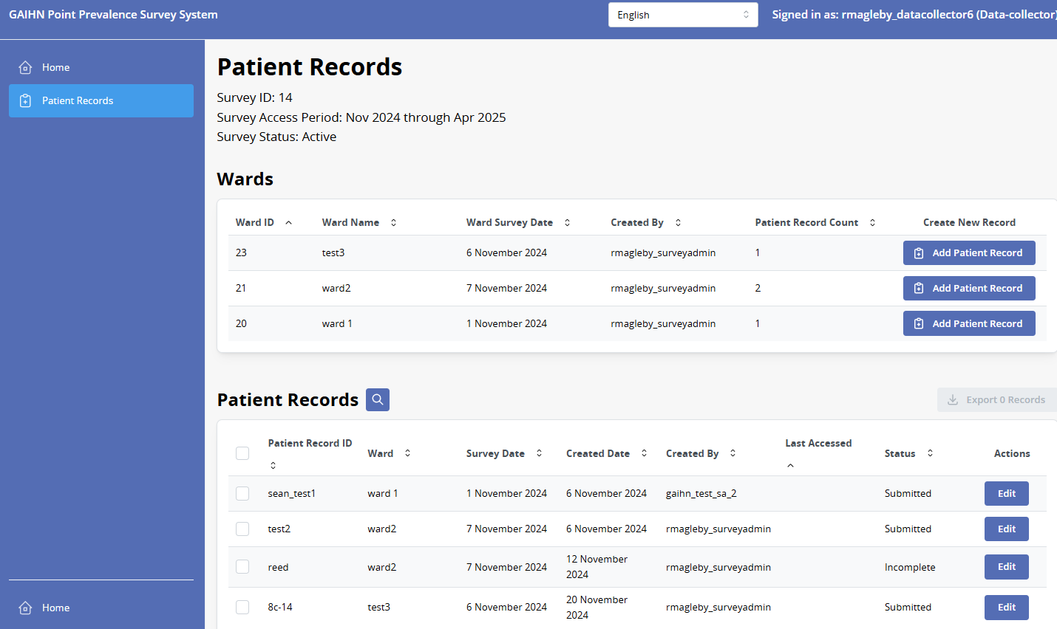
Create a Patient Record – Patient Records page
The Patient Records page shows all of the wards entered for the facility, and the list of patient records that have been entered into the web app
The most recently edited patient will always be at the top of the patient record list
To create and enter data on a patient record click on the Add Patient Record tab on the right of the screen for the appropriate ward
Search
Notes:
The Patient Records page shows all of the wards entered for the facility, and the list of patient records entered into the web app. You are able to sort and search this list using the search function CLICK although by default, the most recently edited patient will always be at the top of the patient record list. Note that data collectors can only see the list of patients that they have created, while survey administrators can see all patient records associated with the current survey
To create a patient record and enter data about that patient, click on the Add Patient Record tab CLICK on the right of the screen for the appropriate ward. Double check that you are clicking add patient record for the ward that the patient is currently admitted to.

Slide 13
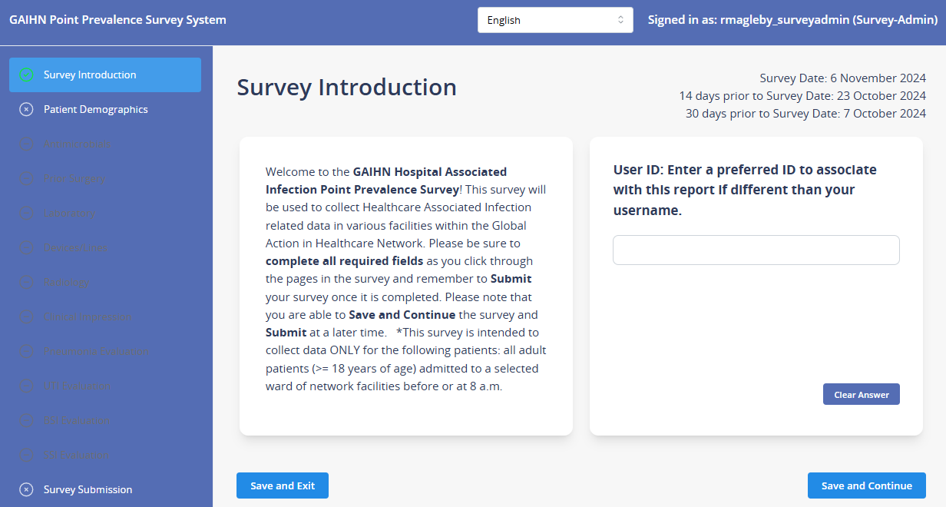
Create a Patient Record – Survey Introduction
Data Collectors
After clicking the Add Patient Record tab for the appropriate ward you will see the Survey Introduction screen with the following:
        Introduction to the survey and instructions.
        A place to enter a User ID besides your username. This allows the survey administrator to track which patient records you have created.
Click on Save and Exit if you want to create a Patient Record but do not want to enter patient data at this time.
Click on Save and Continue if you want to enter patient data
        The patient record is created after you click Save and Exit or the Save and Continue
Notes:
After clicking the Add Patient Record tab for the appropriate ward, the first page shown is the survey introduction page. This page includes:
An Introduction to the survey and instructions.
And, a place to enter a User ID besides your username. Entering a name here allows the survey administrator to track which patient records you have created.
Click on Save and Exit if you want to create a Patient Record but do not want to enter patient data at this time. This will bring you back to the previous Patient Records page.
Click on Save and Continue if you want to enter patient data
The patient record is created after you click either Save and Exit or the Save and Continue. The save and exit and save and continue buttons will be present on all forms. Always click save and continue to save your data and continue collecting data on the current patient. Use save and exit to leave the form and come back later.

Slide 14
Create a Patient Record – Survey Introduction
Data Collectors
On the left side of the screen, you will see a list of all the patient forms in the PPS. Note that many are greyed out, and do not need to be filled out unless the system determines that more information is needed to fulfill HAI case definitions
Notes:
On the left side of the screen, you will see a list of all the patient forms in the PPS. Note that many are greyed out, and do not need to be filled out unless the system determines that more information is needed to fulfill HAI case definitions. For now, only the patient demographics form is available.

Slide 15
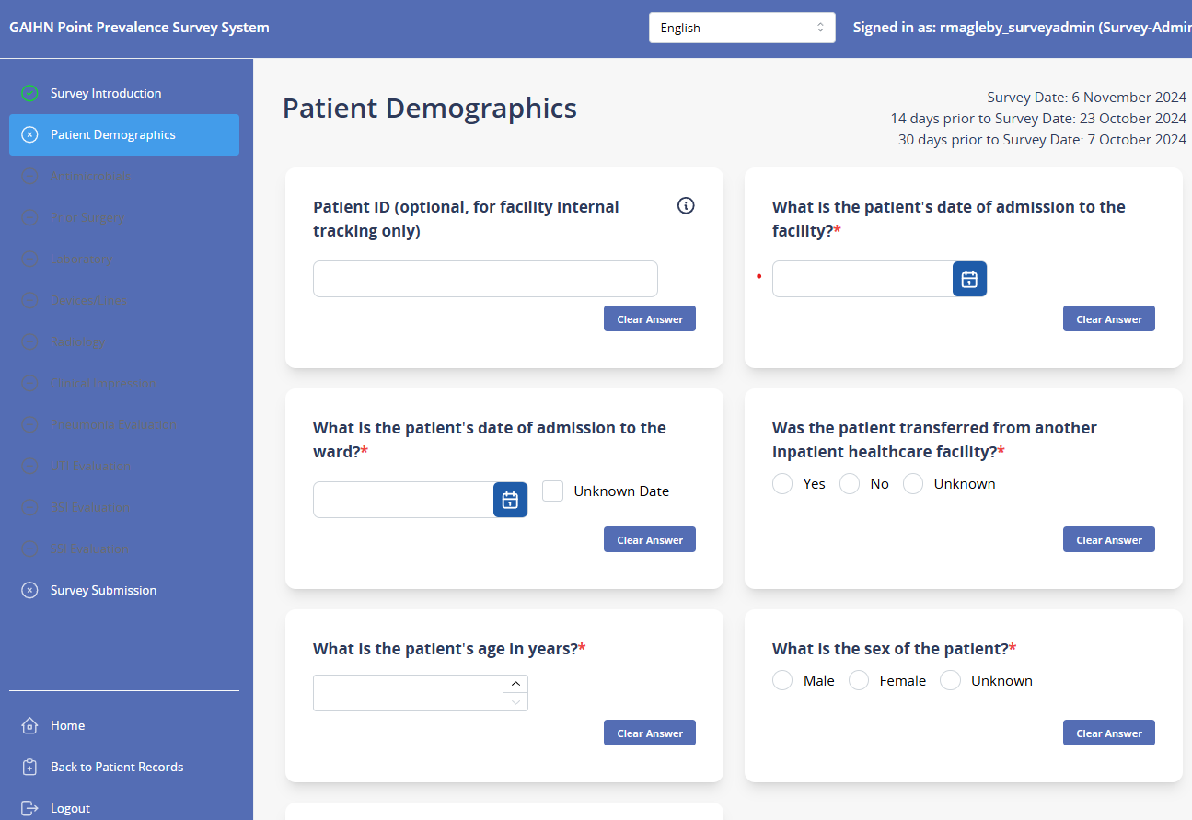

Enter Patient Record data - Patient Demographics
Enter the Patient Demographics data
        Patient ID is an optional field that can be used for internal tracking of PPS patients. The patient ID can be determined by the facility and should not be shared outside of the healthcare facility
Hover over or click
tool tips for additional information and data entry tips
Fields marked with * are required. Most questions in the survey are required fields
Either click Save and Exit to return later or Save and Continue to proceed to the next form
Notes:
On the patient demographics form, enter data about the patient including their date of admission to the facility, date of admission to the ward, whether or not they were transferred from another healthcare facility, and their age and sex. Patient ID is an optional field that can be used for internal tracking of PPS patients. The patient ID can be determined by the facility and should not be shared outside of the healthcare facility. For additional information on questions, you may hover over or click on tooltips for additional information about the question. If you have additional questions, you may reference the FAQ or ask a member of the survey team.
Note that questions marked with a red asterisk are required to proceed. Most questions in the survey are required, but if you do not know the answer to a question, you should always be able to mark “unknown” instead of leaving it blank.
After completing the demographics form, either click Save and Exit to return later or Save and Continue to proceed to the next form

Slide 16
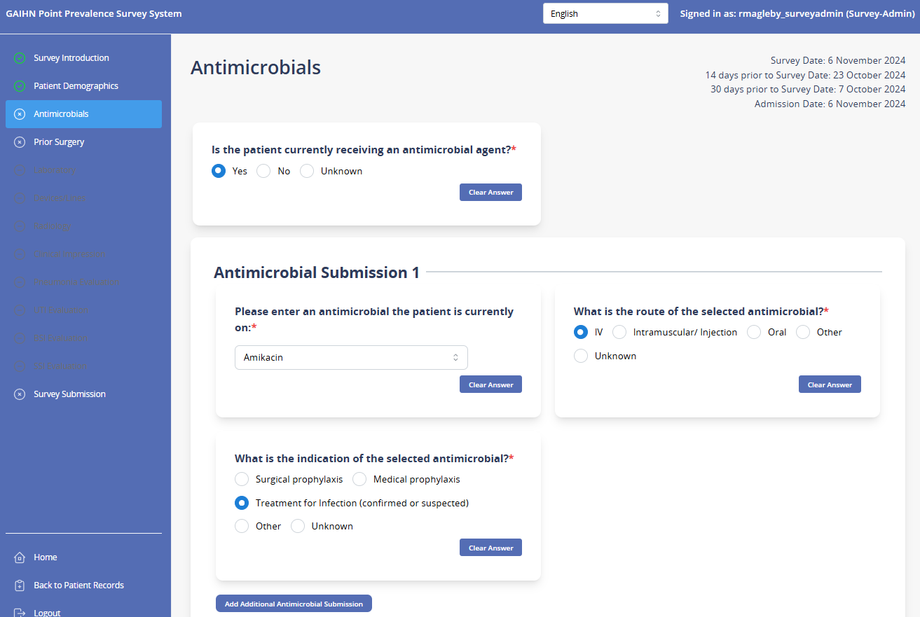
Enter Patient Record data - Antimicrobials
Enter data on antimicrobials that the patient is receiving on the survey date.
    Include information on the route and indication of the antimicrobial as available
Click “add additional antimicrobial submission” to add additional antimicrobials that the patient is receiving
Either click Save and Exit to return later or Save and Continue to proceed to the next form
Notes:
On the antimicrobial form, Enter data on antimicrobials that the patient is receiving on the survey date. Include information on the route and indication of the antimicrobial as available
Click CLICK “add additional antimicrobial submission” to add additional antimicrobials that the patient is receiving
Either click Save and Exit to return later or Save and Continue to proceed to the next form

Slide 17
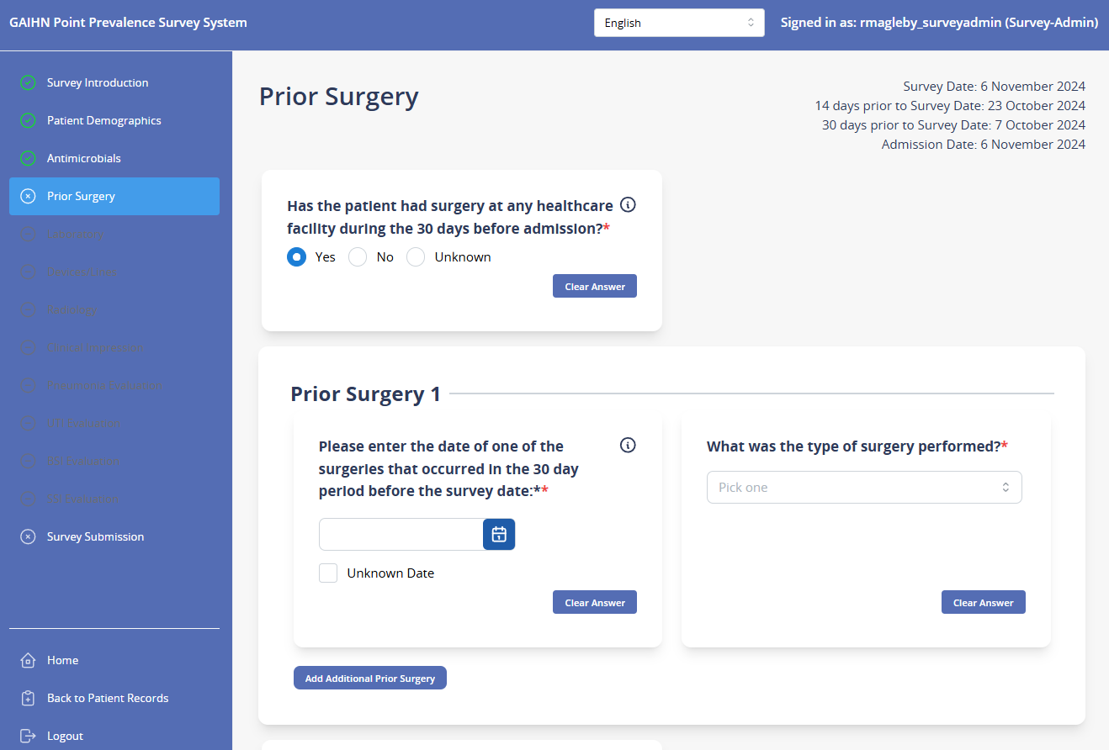
Enter Patient Record data – Prior Surgery
Enter data on surgeries that the patient has had during the right-hand period before the survey date
        Include surgeries that were performed at the current facility as well as other facilities
        Use date calculations in the upper right hand corner to help determine if a surgery falls within the 30 day period
        If unclear if a particular procedure should be recorded on this form, check with the survey administrator or consult the PPS FAQ
Click “add additional prior surgery” to add additional surgeries beyond the first
Either click Save and Exit to return later or Save and Continue to proceed to the next form
Date Calculations
Notes:
On the prior surgery form, enter data on surgeries that the patient has had during the 30 day period before the survey date
Make sure to Include surgeries that were performed at the current facility as well as other facilities,
CLICK Also, make use the date calculations in the upper right hand corner, to help you determine if a surgery falls within the 30 day period
If unclear if a particular procedure should be recorded on this form, check with the survey administrator or consult the PPS FAQ
When entering a surgery, try your best to pick a category of surgery from the drop down list that most closely matches the procedure.
After entering the information on one surgery, Click “add additional prior surgery” to add additional surgeries beyond the first
Either click Save and Exit to return later or Save and Continue to proceed to the next form

Slide 18
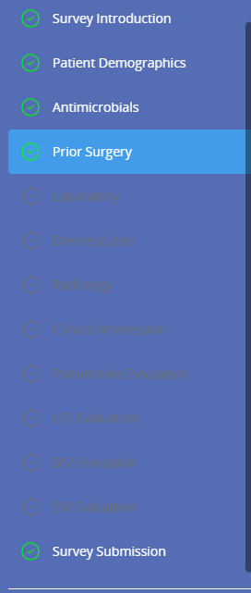
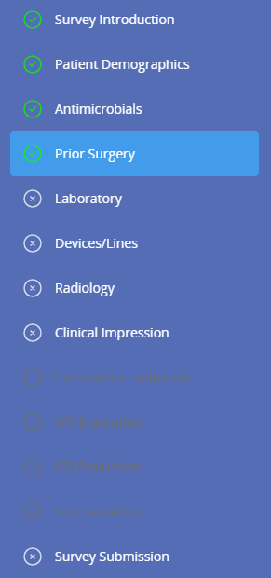
Enter Patient Record data
For some patients, data entry will continue with additional forms:
Laboratory
Devices/Lines
Radiology
Clinical Impression
For some patients, data entry will stop here. These patients do not meet criteria for further chart review and no further data collection is needed
Notes:
After completing the survey introduction, patient demographics, antimicrobials, and prior surgery forms, data entry will stop for many patients. These are patients who are unlikely to have an HAI and do not meet the system’s criteria for further chart review. No further data collection is needed for these patients. For some patients, additional data collection is needed, and the system will guide you through the laboratory, devices/lines, radiology, and clinical impression forms

Slide 19
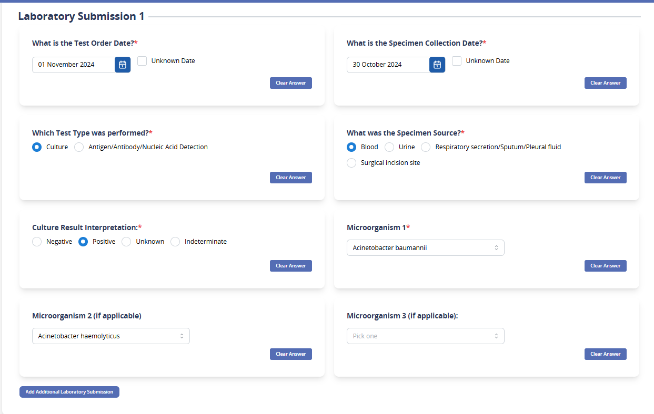
Enter Patient Record data – Laboratory Form
If routed to the laboratory form, use this form to enter data on microbiology and urinalysis test that been performed during the 14-day period before the survey date
          Culture/Antigen/Antibody/
          Nucleic Acid Results
            Source
            Order/Collection dates
            Result
            Organism(s)
        Click “add additional laboratory test” to add additional laboratory tests beyond the first
Microbiology Data Requested:
Notes:
On the laboratory form, enter data on microbiology and urinalysis tests that been performed during the 14-day period before the survey date
Microbiology tests to be include culture ,antigen, antibody, and nucleic acid test results. If a particular microbiology test is not available as an option for the form, it does not need to be collected. For each microbiology test, you will need to know:
The source (for example, blood, urine, respiratory tract)
The order OR the collection date
Result (for example, positive or negative)
Any organisms identified on the test (for which you can enter up to three
Click “add additional laboratory submission” to add additional microbiology tests beyond the first

Slide 20
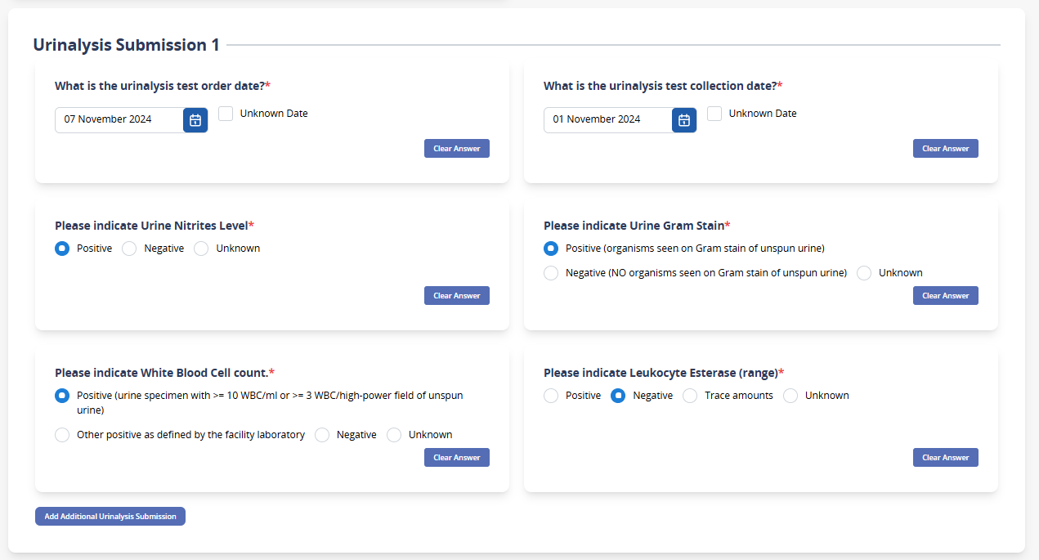
Enter Patient Record data – Laboratory Form
If routed to the laboratory form, use this form to enter data on microbiology and urinalysis test that been performed during the 14 day period before the survey date
          Urinalysis results
            Order/collection date
            Nitrites
            Gram Stain
            WBC count
            Leukocyte esterase
        Click “add additional urinalysis submission” to add additional urinalysis beyond the first
Urinalysis Data Requested:
Notes:
Below the microbiology submission, you will be able to enter information on urinalysis tests
Information to be collected includes:
Order date OR the collection date
Nitrites
Gram Stain
WBC count
Leukocyte esterase
Click “add additional urinalysis submission” to add additional urinalysis tests beyond the first

Slide 21
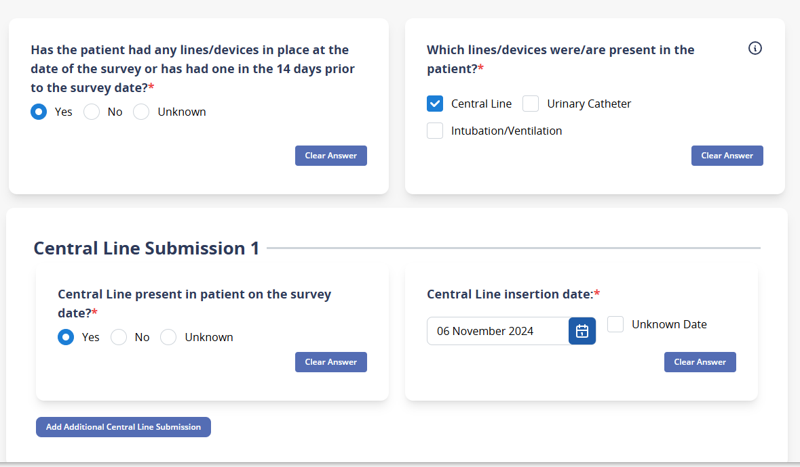
Enter Patient Record data – Devices/Lines
If routed to the Devices/Lines form, use this form to enter data on devices and lines in place on the survey date or in the 14 days prior
  Central Venous Lines
  Indwelling Urinary Catheters
  Intubation/Mechanical ventilation
        Refer to tooltips and/or the FAQ for information on what should be considered a central venous line
        Click “add additional line” to add additional devices/lines of that type beyond the first
Notes:
On the devices/Lines form, enter data on devices and lines in place on the survey date or in the 14 days prior
The three types of devices collected in the survey are:
Central Venous Lines
Indwelling Urinary Catheters
Intubation/Mechanical ventilation
You should refer to tooltips on this form and/or the FAQ for information on what should be considered a central venous line
After entering information on the device, including whether it is present on the survey date, the insertion date, and the removal date (if applicable), Click “add additional line” to add additional devices/lines of that type beyond the first.

Slide 22
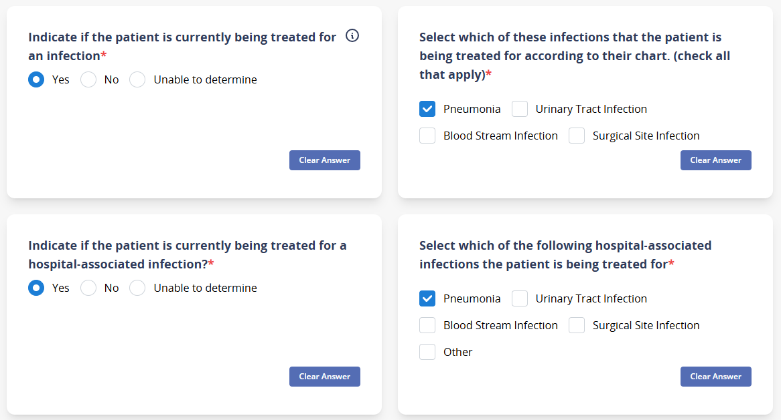
Enter Patient Record data – Clinical Impression
If routed to the Clinical Impression form, use this form to enter data on known infections and hospital-associated infections that the patient is currently being treated for
        For each of the two questions, select all infections or hospital-associated infections that the patient is known to have and is being treated for
Data collectors do not need to make this determination and should only record if the information is available in the medical record. If not, click “unable to determine”
Notes:
On the clinical impression form, enter data on known infections and hospital-associated infections that the patient is currently being treated for. Data collectors do not need to make this determination and should only record if the information is available in the medical record. If this information is not available, choose the option “unable to determine”. For both the question on infections and hospital-associated infections, select the infections that the patient is being treated for after answering yes.

Slide 23
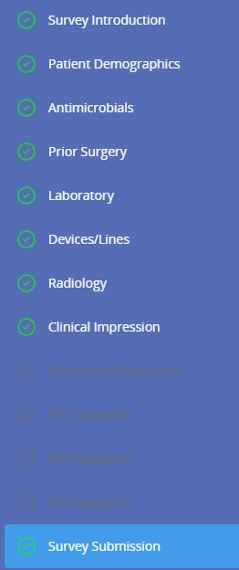
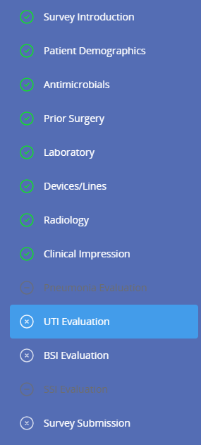
Enter Patient Record data
For some patients, data entry will continue with One or multiple additional forms
Pneumonia Evaluation
UTI Evaluation
BSI Evaluation
SSI Evaluation
For some patients, data entry will stop here. These patients do not need further evaluation for specific infections
Notes:
For some patients, data entry will stop after filling out the clinical impression form. These patients do not need further evaluation for specific infection. For patients that meet criteria for a review for signs and symptoms of specific diseases, data entry will continue with one or multiple additional forms. These forms are the pneumonia, UTI, BSI , or SSI evaluation forms.

Slide 24
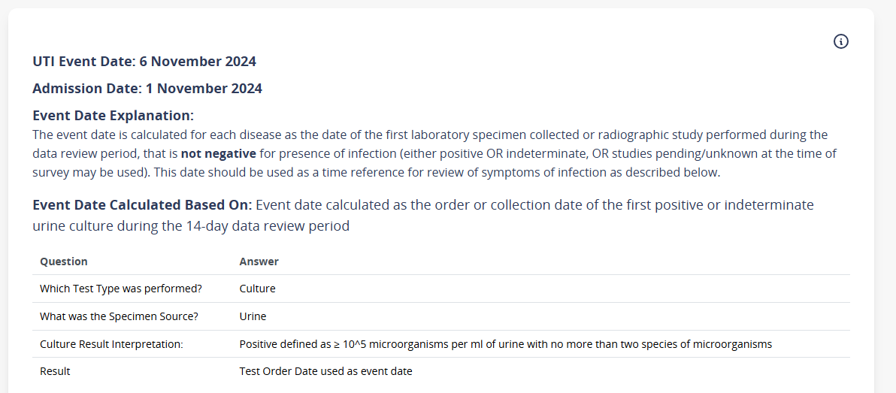
Enter Patient Record data – HAI Classification data & Event Date
If the patient meets criteria for further review for a specific infection, you will be sent to enter additional HAI Classification data for each of these infections
These forms primarily focus on the presence of signs or symptoms.
The system will automatically calculate an event date for each disease and display it at the top of each disease form along with information on how the event date was calculated
Notes:
If the patient meets criteria for further review for a specific infection, you will be sent to enter additional HAI Classification data for each of these infections, which involves a review for signs and symptoms of specific infections. The time period for symptom review focuses around the event date CLICK, which is automatically calculated by the system and is displayed at the top of the disease form. The way that the system calculates event date is covered in training module 2.

Slide 25
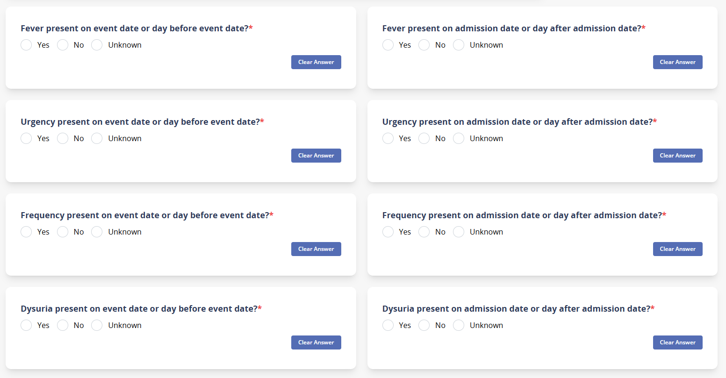
Enter Patient Record data – HAI Classification data & Event Date
For each symptom displayed in the form, the data collector should mark whether that symptom is present during two separate time periods:
      Event date or the day before the event date
      Admission date or the day after the admission date
Select “No” if symptoms are recorded but the described symptom is not present, select “unknown” if no symptoms are recorded
Notes:
For each symptom displayed in the form, the data collector should mark whether that symptom is present during two separate time periods:
Whether that symptom is present on the event date or the day before the event date
OR
Whether the symptom was present on the admission date or the day after the admission date
For each symptom, Select “No” if symptoms are recorded but the described symptom is not present, and select “unknown” if you can’t find any part of the chart where symptoms are recorded
Each disease form will ask about different symptoms. As you can see here, the UTI form asks about the presence of fever, urgency, urinary frequency, and dysuria, in addition to several other symptoms that can be use to meet the UTI case definition, such as flank pain and tenderness.

Slide 26
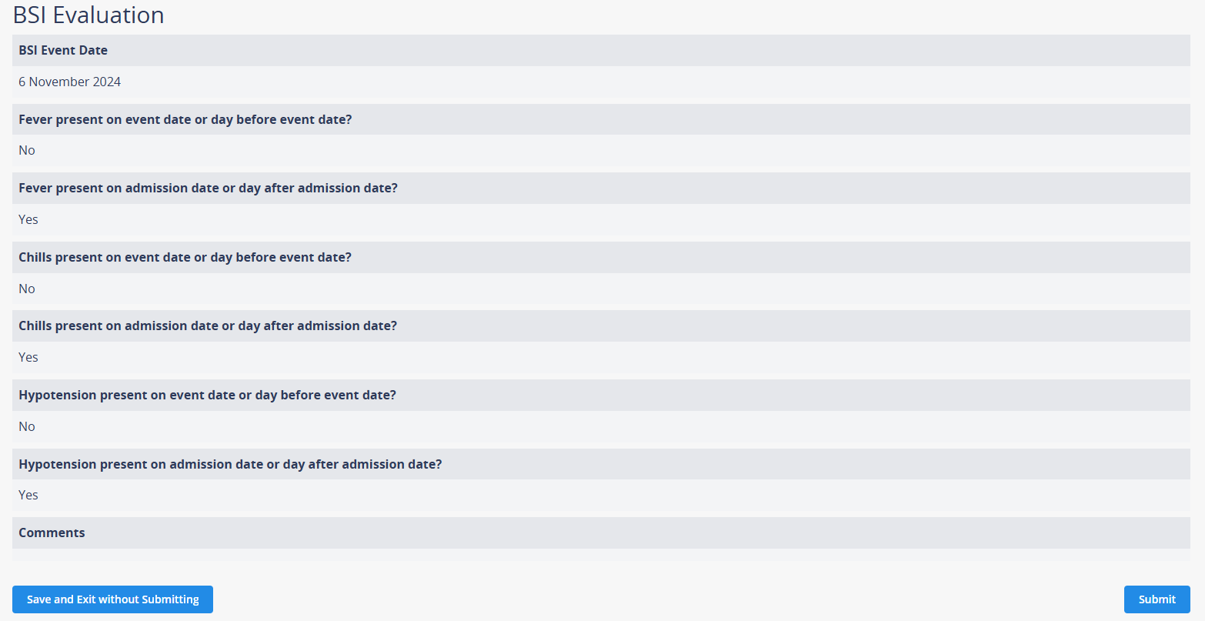
Survey Submission Page - Review and Submit Data
The Survey Submission page is the final page of the survey, which allows you to review your responses.
Carefully review your answers to ensure the responses are accurate.
You may:
        Save and exit without submitting: if all fields are complete, this will mark the record as “complete”
        Submit: This will mark the record as “submitted”
Notes:
After completing all previous forms, The Survey Submission page is the final page of the survey, which allows you to review your responses.
All the responses to your questions are displayed on this page. You should carefully review your answers to ensure the responses are accurate and then proceed by selecting one of two options:
CLICK The first option is to click save and exit without submitting: this will mark the record as either incomplete, of some fields are still missing, or incomplete if all fields in all forms are complete. You can use this option if you are not yet ready to submit the record
CLICK The second option is to click Submit, this will mark the record as “submitted” and can be used to indicate that the record is ready for analysis and HAI determination and requires no further review

Slide 27
Survey Submission
Patient records in the app have three states:
Incomplete:
not all fields are complete
Complete:
All fields are complete
Submitted:
All fields are complete AND the “submit” button has been pressed
Notes:
Based on the selection at the end of the survey submission page, records in the web app have three states. Incomplete records, are those where not all fields are complete. These are records that are likely still in progress. Complete records are those where all data fields are complete, but the data collector has not yet hit the submit button. And submitted records, are those where all fields are complete and the user has clicked the submit button. These are records, that would be considered ready for analysis and HAI determination. Although all records, including submitted records can still be edited after the survey, data collectors and survey admins may use this system to classify and indicate records that need further review before submitting. Ways to use this system will be covered in more detail in future modules.

Slide 28
Edit/Search Patient Records – Patient Records Page
Data Collectors can edit or add patient data from their Patient Records page
Go to the Patient Records lookup section and click edit for the patient record you would like to edit.
      Note: Patient records marked as “submitted” can still be edited
You may also search the patient records that you entered by clicking on the search icon.
Notes:
After the survey submission page, data collectors will turn back to the patient records page. From the patient records page, data Collectors can add additional patient records, or edit patient records that they have already started.
You can edit patients that have been already created by clicking on the edit button on the right side. Note that even patient records marked as “submitted” can still be edited
You may also CLICK search the patient records that you entered by clicking on the search icon.

Slide 29
Data Entry and Management for Survey Admins
Notes:
We will now go over the process of entering data for survey admins, with a focus on the facility and ward forms.

Slide 30
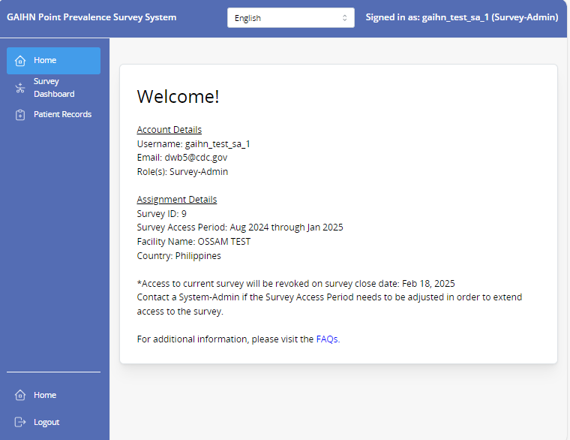
Home Page (after login)
Survey Administrators
After logging in, survey administrators will see the following welcome page.
On this page and on any other page in the app, the language can be selected
The survey administrator has the following permissions and responsibility to manage the survey
        Enter facility data
        Create wards and enter ward data
        Export facility and ward reports
        The survey administrator may also create and enter patient records and edit patient records of other data collectors
To enter facility data, create wards and enter ward data navigate to the left side of the screen and click on Survey Dashboard
Notes:
After logging in, survey administrators will see the following home page
On this page and on any other page in the app, CLICK the language can be selected
The survey administrator has the following permissions and responsibility to manage the survey
Enter facility data
Create wards and enter ward data
Export facility and ward reports
The survey administrator may also create and enter patient records and edit patient records of other data collectors
To enter facility data, create wards and enter ward data navigate to the left side of the screen and click on Survey Dashboard CLICK

Slide 31
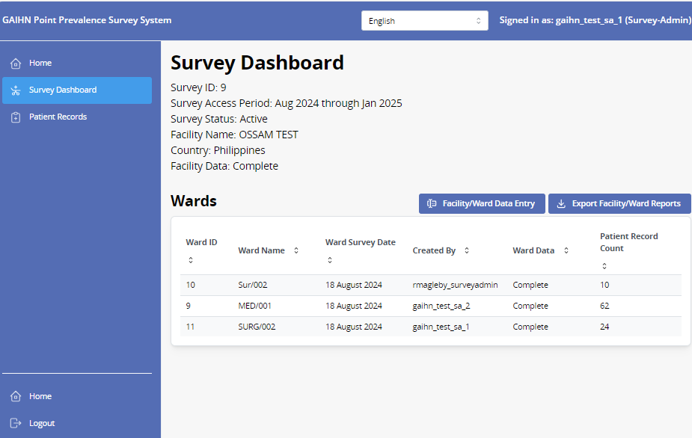
Survey Dashboard
Survey Administrators
The Survey Dashboard shows the following information for survey admins:
      Survey ID
      The Survey Access Period
      Survey Status
      The Facility name and Country for the Survey
      Whether the Facility Data is complete or incomplete
      List of the wards that have been created for this survey
This page is also where facility and ward data are entered and exported:
      Facility/Ward Data Entry
              One facility form should be completed for each survey
              One ward form should be completed for each ward surveyed
      Export Facility/Ward Reports
        Downloads all entered facility/ward data in CSV format
Notes:
The Survey Dashboard shows the following information for survey admins about the currently assigned survey:
The unique Survey ID
The Survey Access Period
The Survey Status
The Facility name and Country for the Survey
Whether the Facility Data is complete or incomplete
List of the wards that have been created for this survey
This page is also where facility and ward data are entered and exported:
Facility/Ward Data Entry
One facility form should be completed for each survey
One ward form should be completed for each ward surveyed
Export Facility/Ward Reports
Downloads all entered facility/ward data in CSV format
Click on the facility/ward data entry tab to enter facility and ward data for the survey

Slide 32
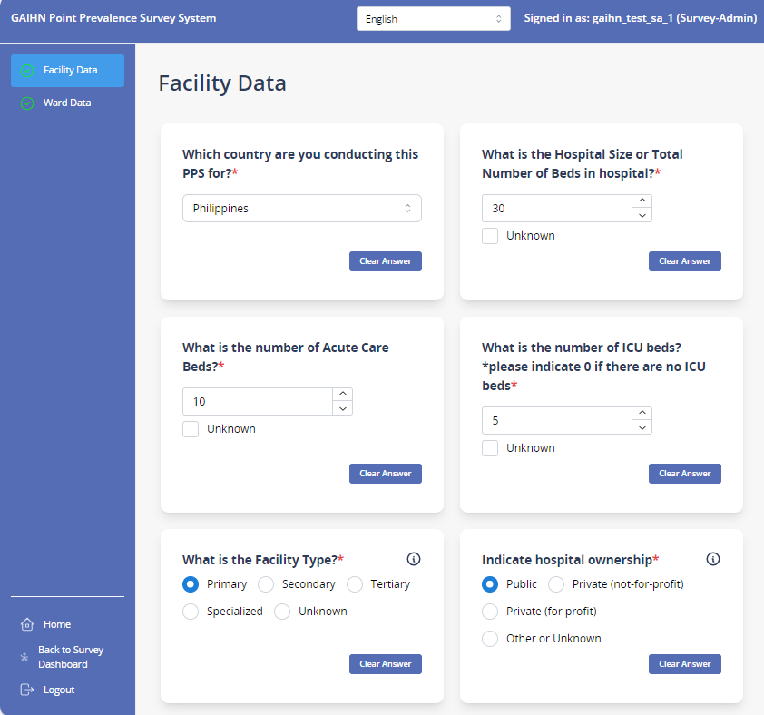
Facility Data page – enter facility data
Survey Administrators
After clicking on Facility/Ward data entry tab you will arrive at the Facility Data page
Questions in the facility form collection information on facility metrics including:
              Facility Type
              Facility Size
              Capacity for IPC
After completing data entry for that facility, click the Save and continue button
Notes:
After clicking on Facility/Ward data entry tab you will arrive at the Facility Data page
Questions in the facility form collection information on facility metrics including:
Facility Type
Facility Size
Capacity for IPC
And others
After completing data entry for that facility, click the Save and continue button

Slide 33
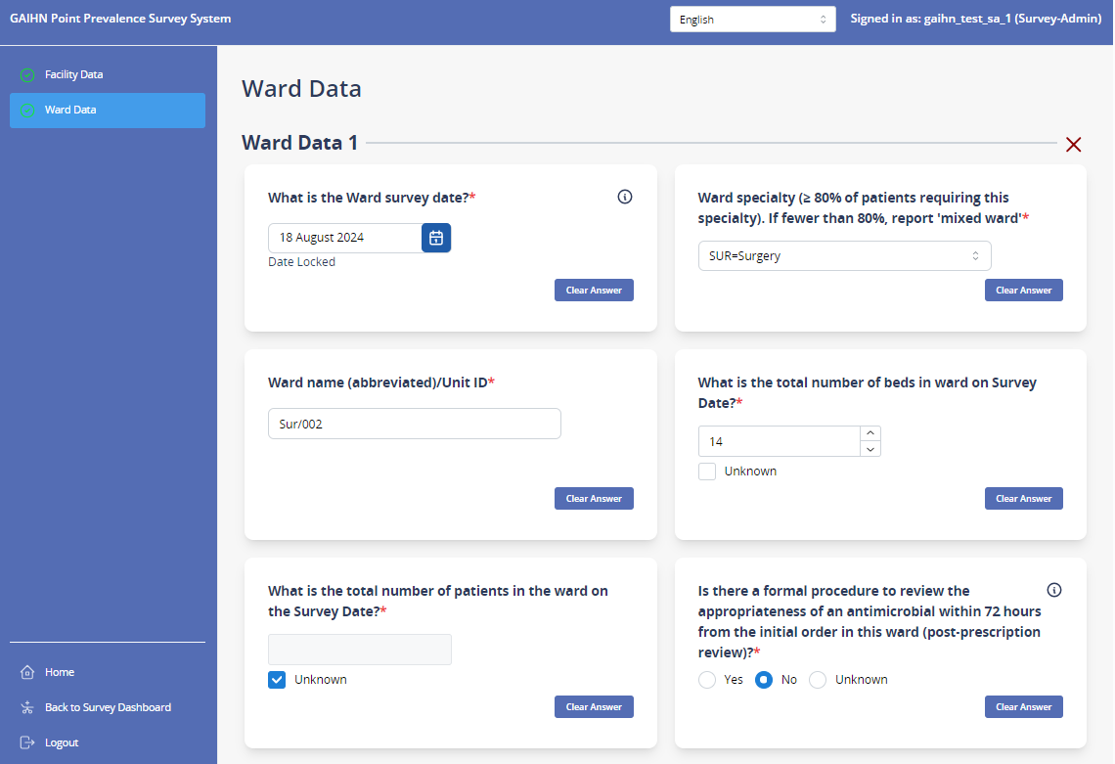
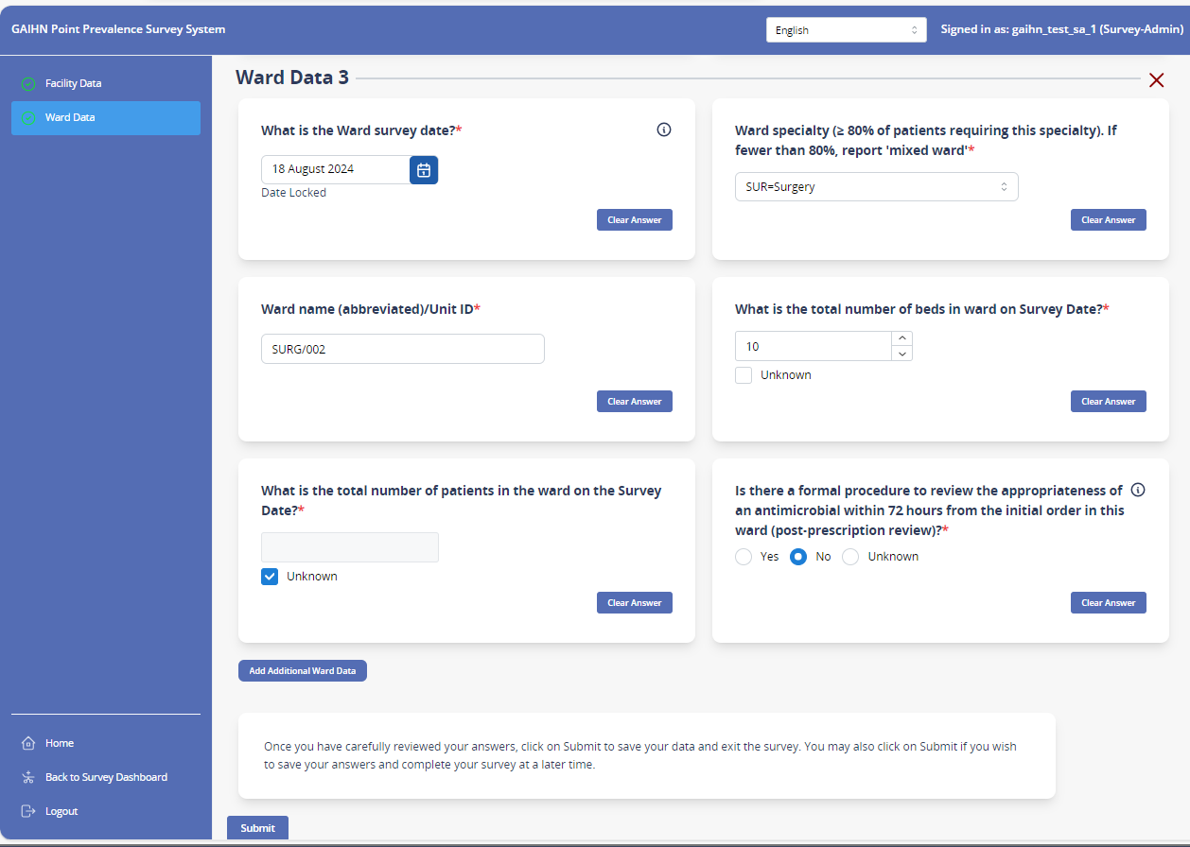
Ward Data page – create wards and enter ward data
Survey Administrators
Navigate to the left side of the screen and click the Ward Data tab
Enter a response to each Ward Data question for that particular ward
After completing data entry for that ward, determine if you will add an additional ward. If you will, click the add additional ward button on the bottom center of the screen.
If this is the last ward you will enter at this time, click the submit button at the bottom center of the screen.
Notes:
In addition to entering information on the healthcare facility, survey administrators will also enter information on each ward included in the survey. To enter ward data,
Navigate to the left side of the screen and click the Ward Data tab CLICK
Enter a response to each Ward Data question for that particular ward
After completing data entry for that ward, determine if you will add an additional ward. If you will, click CLICK the add additional ward button on the bottom center of the screen.
If this is the last ward you will enter at this time, click the submit button CLICK at the bottom center of the screen.

Slide 34
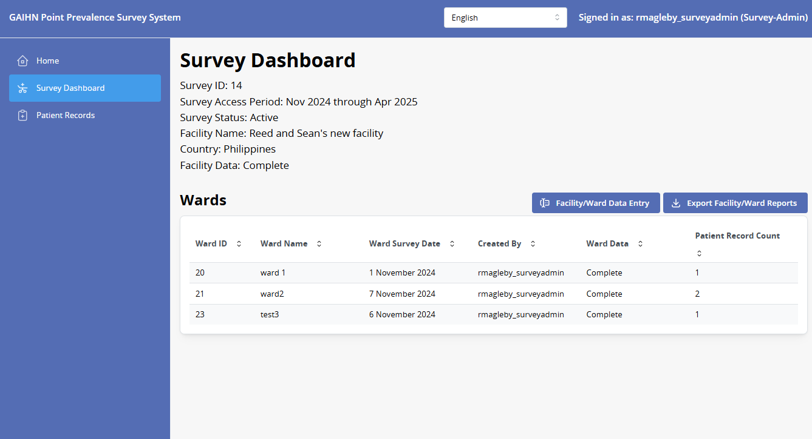
Ward Data page/Survey Dashboard – edit facility/ward data
Survey Administrators
Survey Dashboard
After submitting ward data, the survey dashboard page will be updated with information on that ward, including the ward survey date.
Also shown are whether the ward data is complete, and the number of patient records associated with that ward.
*Note: All ward data does not have to be complete before patients are added to that ward. Only a ward survey date is needed prior to adding patients
Notes:
After submitting ward data, the survey dashboard page will be updated with information on that ward, including the ward survey date. CLICK
Also shown on this page, is whether the ward data is complete, and the number of patient records associated with that ward.
*Note: All ward data does not have to be complete before patients are added to that ward and patient data entry can begin without all of the data being present. The exception to this is the ward survey date: A ward survey date is needed prior to adding patients to the survey.

Slide 35
Ward Data page/Survey Dashboard – edit facility/ward data
Survey Administrators
EDIT facility/ward data
Facility and ward data can be edited from the survey dashboard tab by clicking on “facility/ward data entry”
Note: you may not change the ward survey date after it was submitted the first time. Contact a system admin if your ward survey date needs to be changed.
Notes:
Facility and ward data can be edited from the survey dashboard tab by clicking on the “facility/ward data entry” button CLICK
Note that you may not change the ward survey date after it was submitted the first time and you should contact a system administrator if your ward survey date needs to be changed.

Slide 36
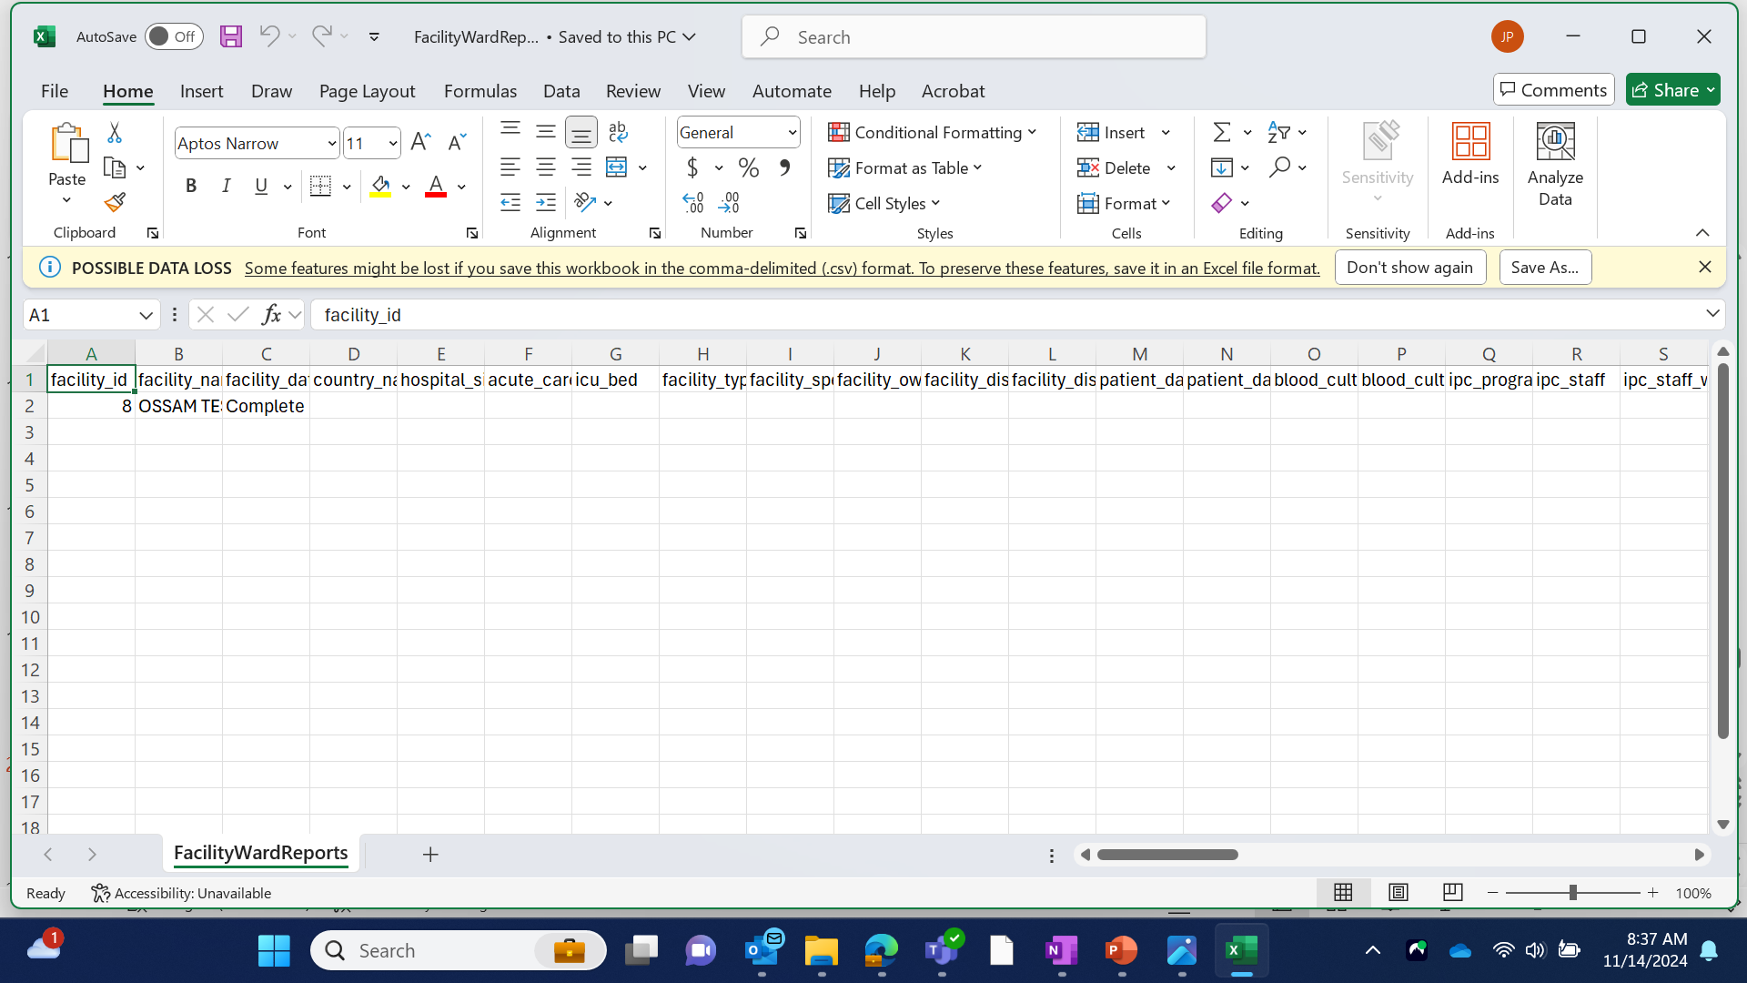
Export Facility/Ward Reports – to excel
Survey Administrators
Create export file
EXCEL Spreadsheet report
If you would like to export the facility and ward data to an excel spreadsheet, click the “Export Facility/Ward Reports” tab on the Survey Dashboard page
Notes:
If you would like to export the facility and ward data to an excel spreadsheet, click CLICK the “Export Facility/Ward Reports” tab on the Survey Dashboard page

Slide 37
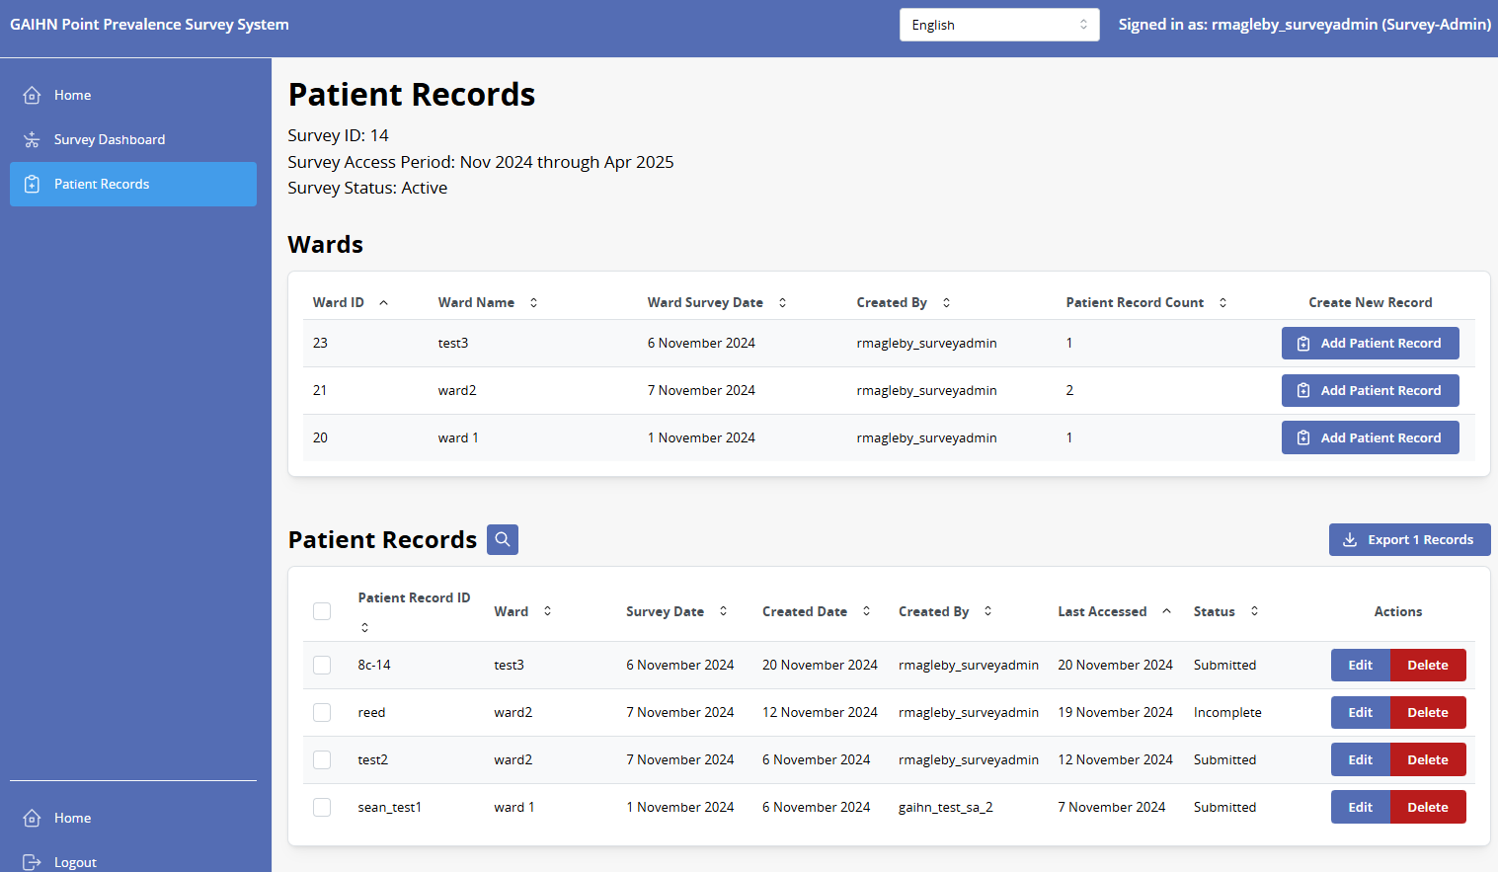
Edit/Search Patient Records – Patient Records Page
Survey Administrator
Survey admins can view a summary of all ward and patient data from the patient records Page
The Patient Records page shows all of the wards entered for the facility, and the list of patient records that have been entered by all data collectors
You can sort the different columns on the patient records table by lick on the arrows
You may also search the patient records that have been entered by clicking on the search button
The patient records status column can be used to track data collector progress towards record completion
Search
Status column
Sort
Notes:
Survey admins can view a summary of all ward and patient data from the patient records page
The Patient Records page shows all of the wards entered for the facility, and the list of patient records that have been entered by all data collectors
You can sort the different columns on the patient records table by lick on the arrows CLICK
You may also search the patient records that have been entered by clicking on the search button CLICK
The patient records status column can be used to track data collector progress towards record completion CLICK

Slide 38
Patient Records Status
Patient records in the app have three states:
Incomplete:
not all fields are complete
Complete:
All fields are complete
Submitted:
All fields are complete AND the “submit” button has been pressed
Notes:
As a reminder, the records status column can show one of three statuses for a record: Incomplete records, are those where not all fields are complete. These are records that are likely still in progress. Complete records are those where all data fields are complete, but the data collector has not yet hit the submit button. And submitted records, are those where all fields are complete and the user has clicked the submit button. Although all records, including submitted records can still be edited after the survey, data collectors and survey admins may use this system to classify and indicate records that need further review before submitting.

Slide 39
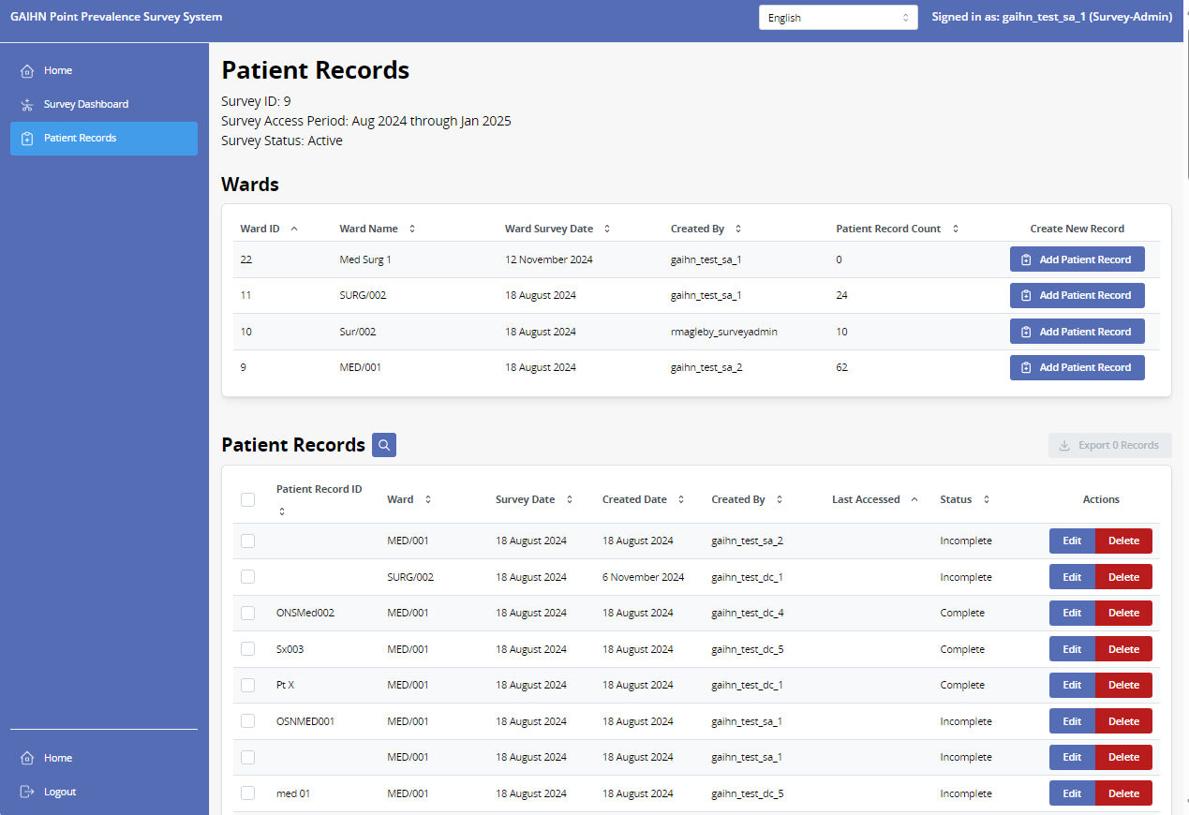
Add/Edit/Delete Patient Record – Patient Records page
Survey Administrator
Add/Edit/Delete Patient Records
Just like data collectors, Survey Administrators can create and enter data for patient records and edit patient records that they created or were created by a data collector assigned to the survey.
Patient record data is accessed from the Patient Records Page
To create and enter data on a patient record, click on the Add Patient Record tab on the right of the screen for the appropriate ward line
To edit a patient record, click edit and then navigate through the patient record to edit or add data
To delete a patient record, click the red Delete button in the Actions column
Notes:
Just like data collectors, Survey Administrators can create and enter data for patient records and edit patient records that they created or were created by a data collector assigned to the survey.
Patient record data is accessed from the Patient Records Page
To create and enter data on a patient record, click on the CLICK Add Patient Record tab on the right of the screen for the appropriate ward line
CLICK To edit a patient record, click edit and then navigate through the patient record to edit or add data
To delete a patient record, click the red Delete button in the Actions column

Slide 40
Tips and Reminders
Notes:
We will finish this session with some tips and reminders about using the web app.

Slide 41
Tips & Reminders
Please note that while navigating the app there are a few reminders all users should keep in mind for successful data collection:
Facility/Ward Data should be collected before patient data collection begins
The ward survey date should be determined prior to starting data collection. The ward survey date should be the same for every patient on a ward. In many cases, data for patients is not entered into the application on the ward survey date itself.
Utilize the data collection FAQ for common questions about data entry.
After you click “Save and Continue“ or “Save and Exit” at the bottom of each page, your patient record data is saved and you can leave and return to enter or edit data on the patient at a later time.
Data collectors can utilize the search function on the Patient Records dashboard to easily lookup a single patient record by Patient Record ID
Survey administrators can utilize the search function to look a set of patient records created by a specific data collector.
Notes:
Facility/Ward Data should be collected before patient data collection begins
The ward survey date should be determined prior to starting data collection and the ward survey date should be the same for every patient on a ward. In many cases, data for patients is not entered into the application on the ward survey date itself.
Utilize the data collection FAQ for common questions about data entry.
After you click “Save and Continue“ or “Save and Exit” at the bottom of each page, your patient record data is saved and you can leave and return to enter or edit data on the patient at a later time.
Data collectors can utilize the search function on the Patient Records dashboard to easily lookup a single patient record by Patient Record ID Survey administrators can utilize the search function to look a set of patient records created by a specific data collector.

Slide 42
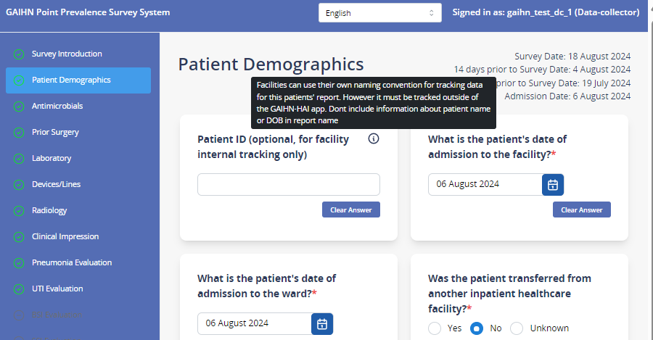
Tooltips
If you hover over the information icon a tooltip will appear that provides helpful descriptions or information on how to respond to the question.
Notes:
Additionally, remember the tooltip function: If you hover over the information icon a tooltip will appear that provides helpful descriptions or information on how to respond to the question.

